Slide 1
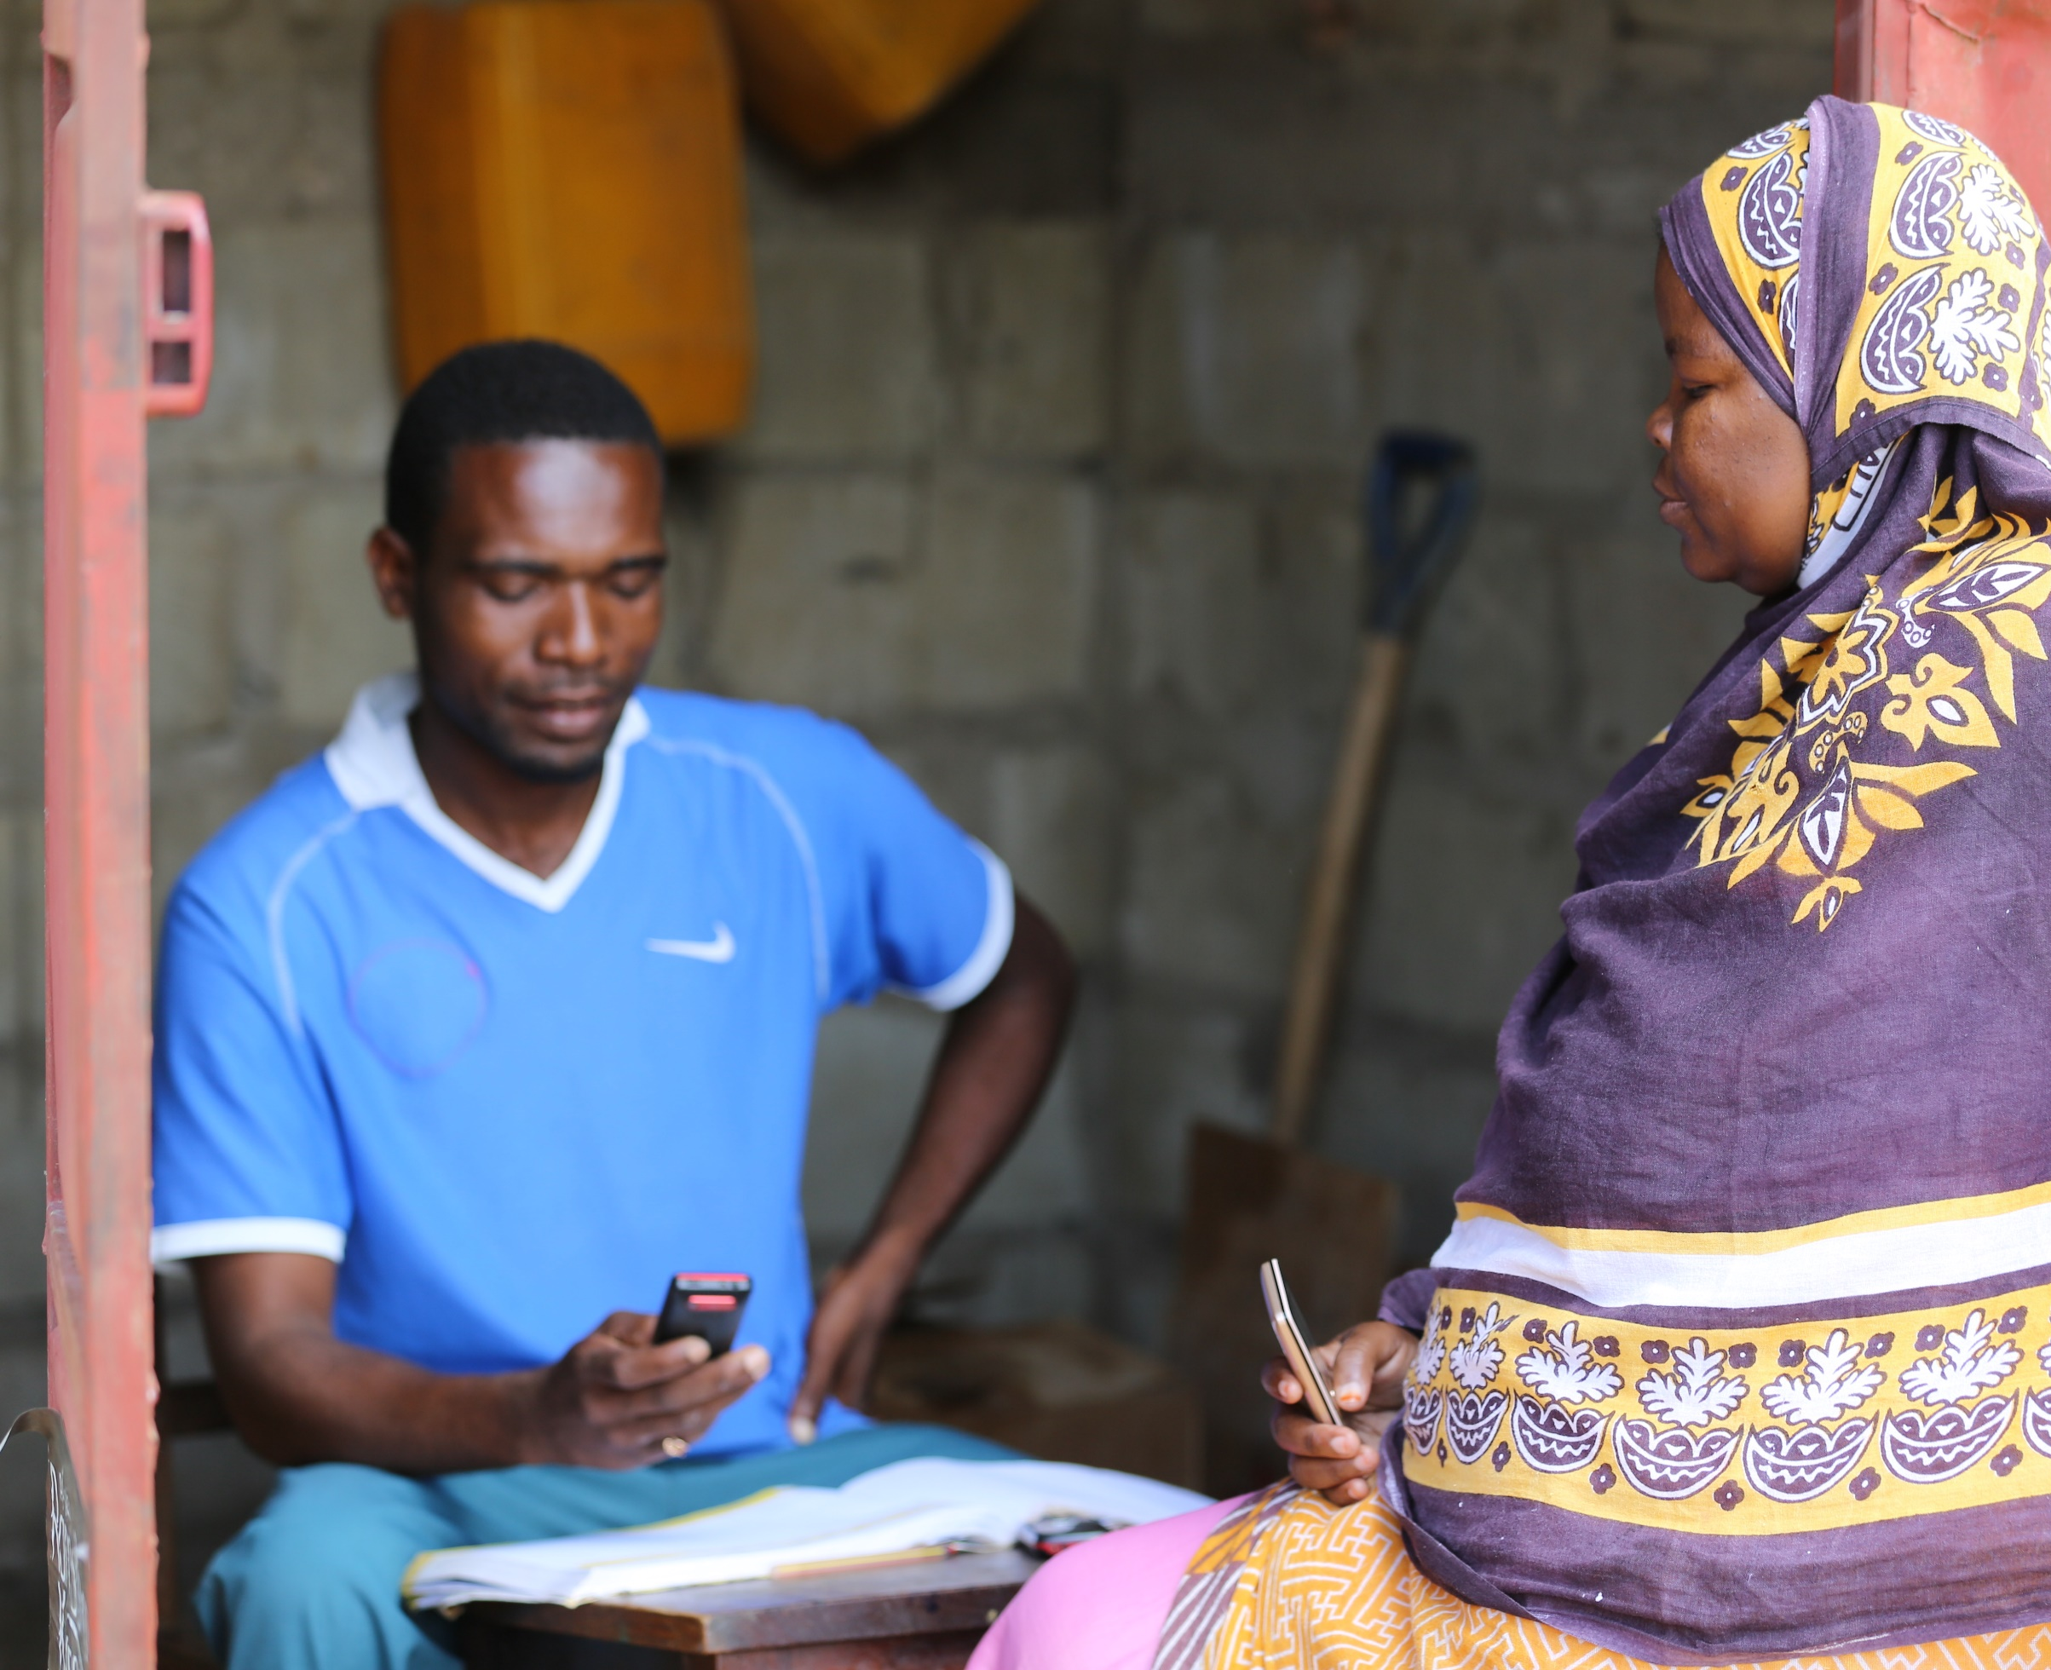
2017

Slide 2
Rethinking Financial Services
Taking Stock of our achievements and forging the way forward
Mobile Financial Services

Slide 3
Uptake of mobile money has grown by 10%-points from 2013

Slide 4
Transactions are the main uptake driver of MFS

Slide 5
2 in 10 MM users do not have their own account

Slide 6
Only one third of mobile money users used the service within the last week
64%
Within last 30 days
82%
Within last 90 days
33%
Within last week
18%
Inactive accounts
Inactive account owners state that the services don’t meet their needs or they don’t need them

Slide 7
Over one quarter utilize more than one provider

Slide 8
Only 13% of mobile money users has ever borrowed via mobile money
Most people borrow 7,000 Tsh
Notes:
4% of adult population has borrowed via MM

Slide 9
Network failure is a key costumer pain point

Slide 10
Easy and quick usage are valued features

Slide 11
Opportunities for MNO’s

Slide 12
Uptake of Mobile Financial Services
58% Growth potential
Development G1: Own phone but stay more than 5 km from an agent & People who have access to a phone and stay within 5 km of access point
Development G2: People who have access to phone but stay more than 5 KM from MM agent
Notes:
Immediate potential: own mobile phone, stay within 5km of access point

Slide 13
Why are they not using MFS?

Slide 14
Why are they not using mobile money?
Build and market use cases beyond transactions

Slide 15
Why are they not using mobile money?

Slide 16
One third of potential users cannot read and write Kiswahili

Slide 17
Potential users are of lower wealth status

Slide 18
Self-reported income by quintiles
PPI quintiles | TZS per month |  | USD per day
 | Mean | Middle value (Median) | Mean | Middle value (Median)
Two lowest quintiles | 125,884 | 41,667 | 2.84 | 0.94
Middle quintile | 178,638 | 90,000 | 4.02 | 2.03
Two highest quintiles | 486,222 | 150,000 | 10.95 | 3.38

Slide 19
Business Owners show a relative high potential for uptake

Slide 20
88% of immediate potential users personally own a mobile phone

Slide 21
Three quarters of the potential users have proof of identification

Slide 22
How can MFS services leverage on other channels? - Potential Linkages

