Slide 2
Methodology and quality assurance
  Sample objective: 800 enumeration areas, 10 interviews per
  EA – 8,000 interviews
  Sample achieved: 7,987 interviews
  Response rate: 99.8%
      6,800 Mainland interviews; 1,187 Zanzibar interviews
      Data weighted and validated by NBS
  Weighted data represents:
      population16 years or older – 24.2 m (21.2m in 2009)
      population18 years or older – 23.2m (20.0 m in 2009)

Slide 3
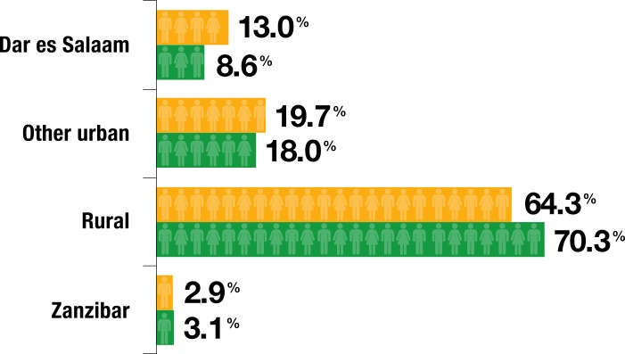
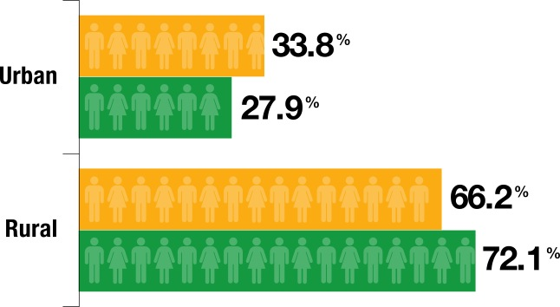
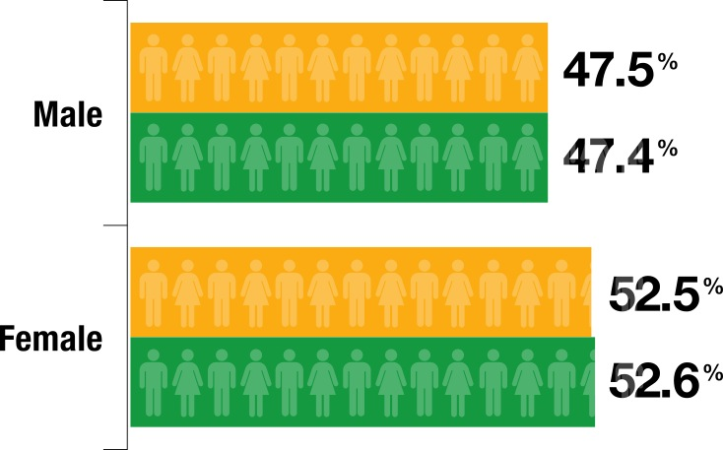
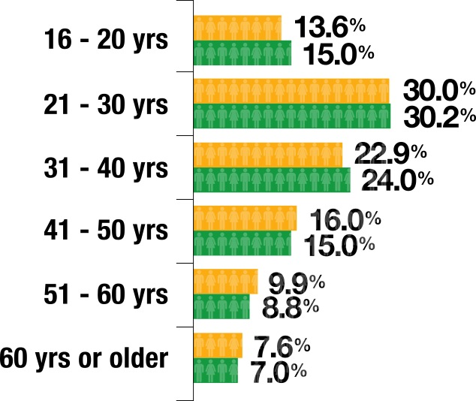
Population 16 years or older demographics

Slide 5
FinScope objectives addressed by the topline findings
  Levels of access to and use of financial services
  Describe the landscape of access
  Barriers to financial access
  Assess trends/change over time

Slide 6
  BoT Target
  50% formal financial access by 2016
  (National Financial Inclusion Framework)
    Is this realistic?
    How have we progressed since 2009?

Slide 7
  Key participants in FinScope Tanzania 2013
Steering Committee
  Stakeholders from public and private sectors
Technical Committee
  BoT, NBS, Ipsos, Technical Advisor, FinScope Coordinator, FSDT
NBS – sampling and quality assurance
Ipsos Tanzania – implemented the survey
Development Pioneer Consultants – FinScope Coordinator
Yakini Development Consulting – Technical Advisor

Slide 8
Definitions of financial inclusion & exclusion
Financially
included
Individuals 16 years or older who have/use financial products/services to manage their financial lives
Financially
excluded
Individuals 16 years or older who use NO financial mechanisms - rely only on themselves/family/friends for saving, borrowing and remitting; their transactions are cash-based or in-kind

Slide 9
Definitions of inclusion
Formally included
Individuals 16 years or older who have/use financial products/ services provided by a financial service provider that is regulated or officially supervised
Informally included
Individuals 16 years or older who use financial mechanisms not provided by a regulated or supervised financial institution

Slide 10
Change in access strand definitions 2009-2013

Slide 11
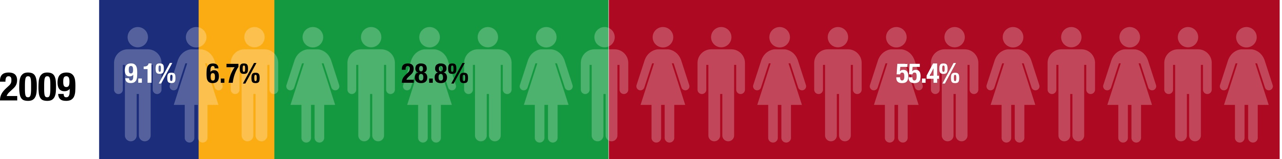
Access strand 2009 – 2013

Slide 12
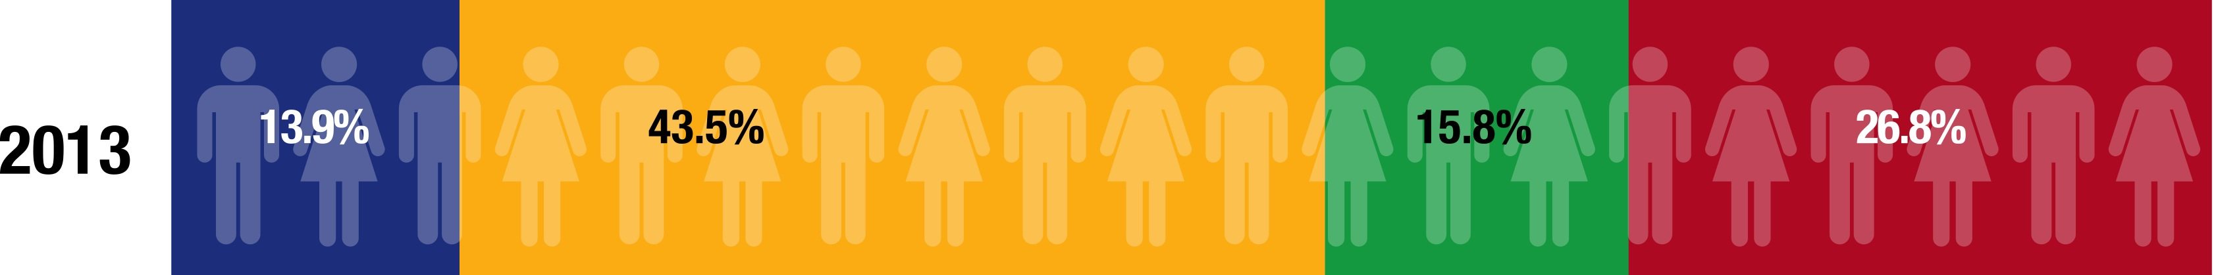
Access strand 2009 – 2013

Slide 13
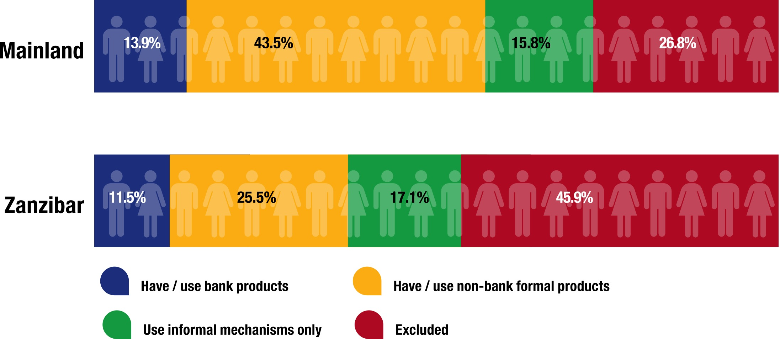
Access strand: Mainland and Zanzibar compared
Zanzibar shows less uptake both in terms of bank and non-bank formal products – adults more likely to be excluded

Slide 14
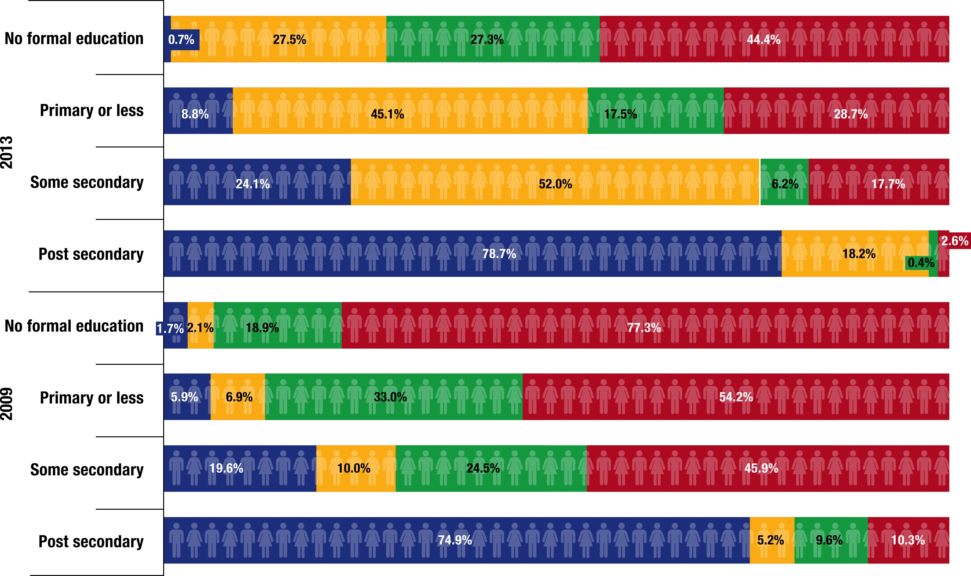
Access strand by education level 2009 - 2013

Slide 15
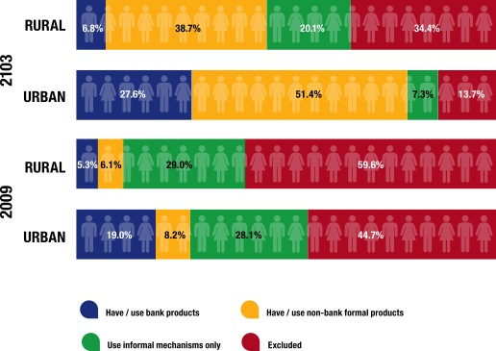
Urban-rural: 2009 - 2013

Slide 16
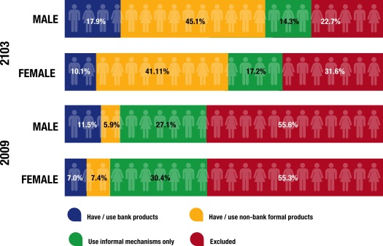
Gender: 2009 - 2013

Slide 17
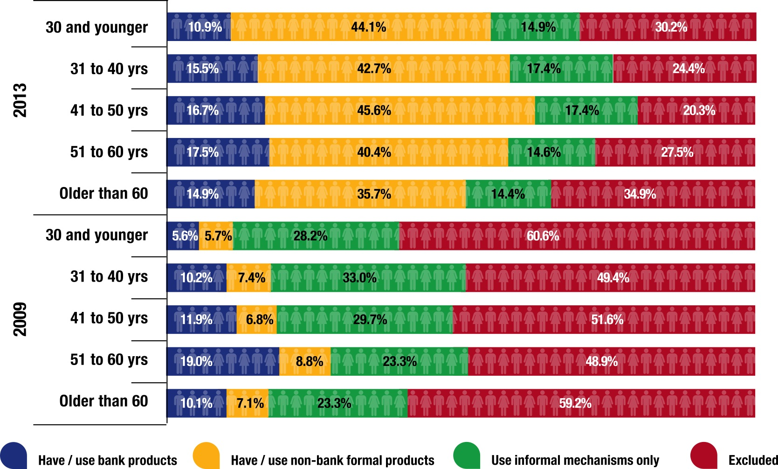
Age categories: 2009 - 2013

Slide 18
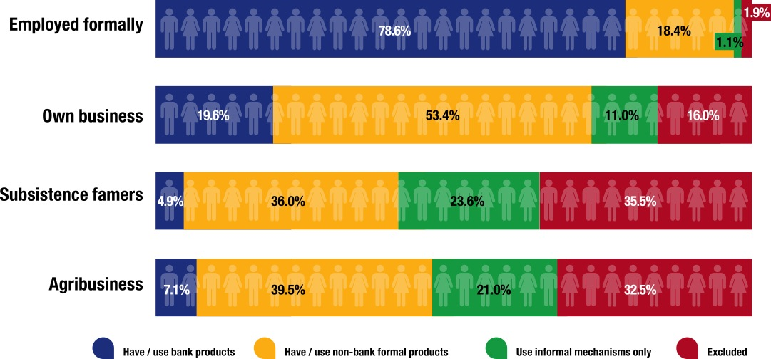
Main sources of money
Only 2% of formally employed are excluded; farmers most likely to be excluded or to rely on informal mechanisms only

Slide 19
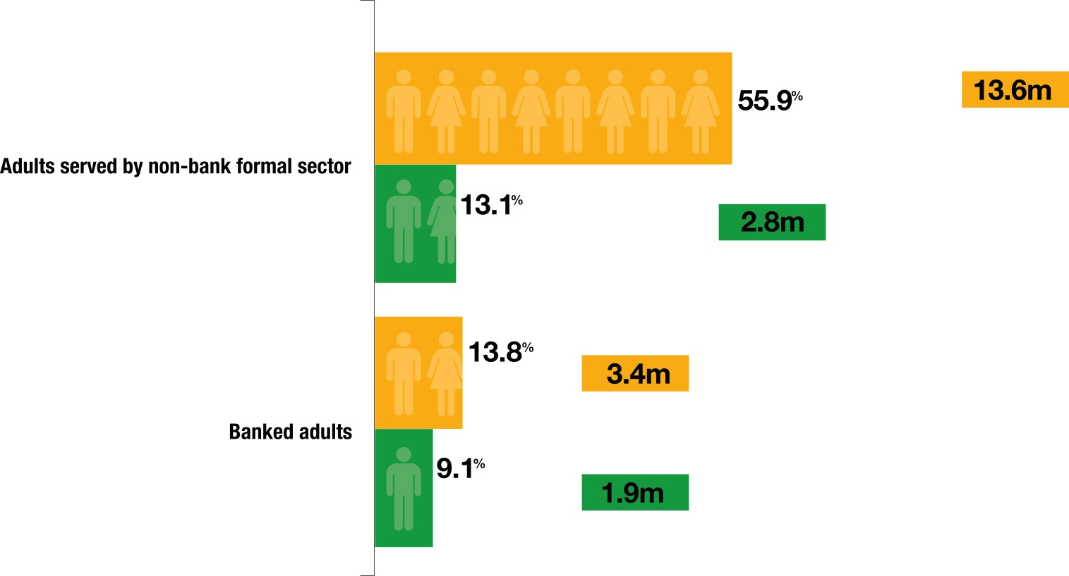
Growth in banking and non-banking sectors

Slide 20
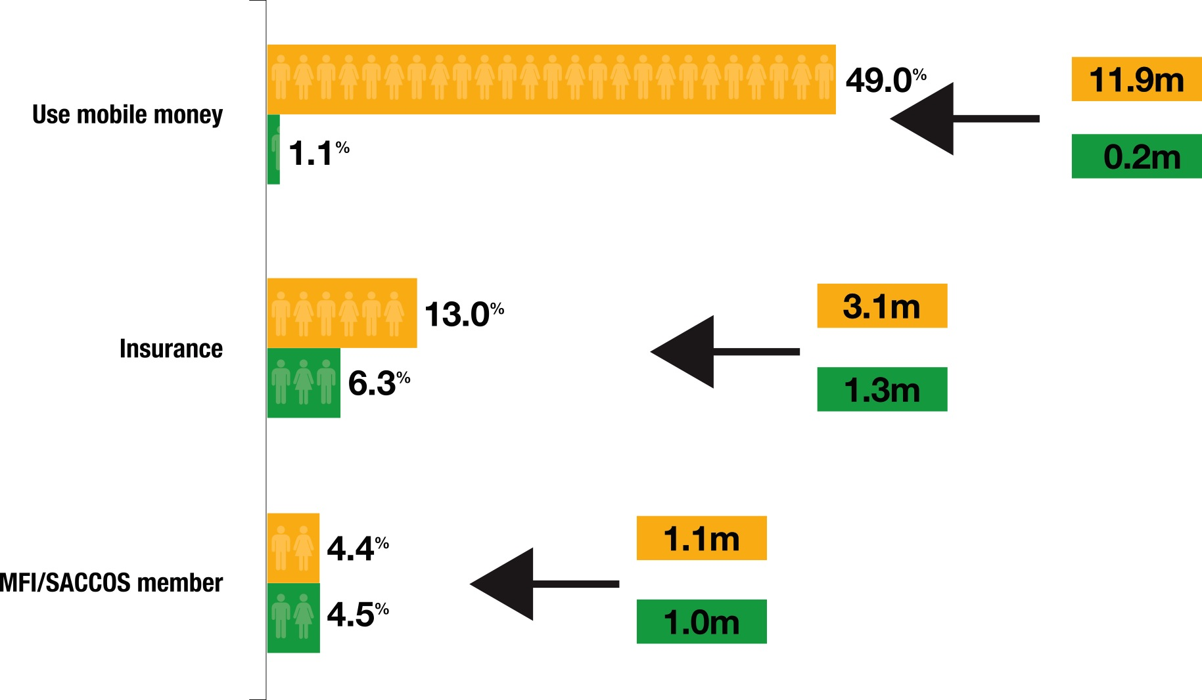
Non-bank formal sector use
Growth in non-bank formal sector driven by increased uptake of and mobile money and insurance

Slide 21
11.9 m users of mobile money - what are they using it for?

Slide 22
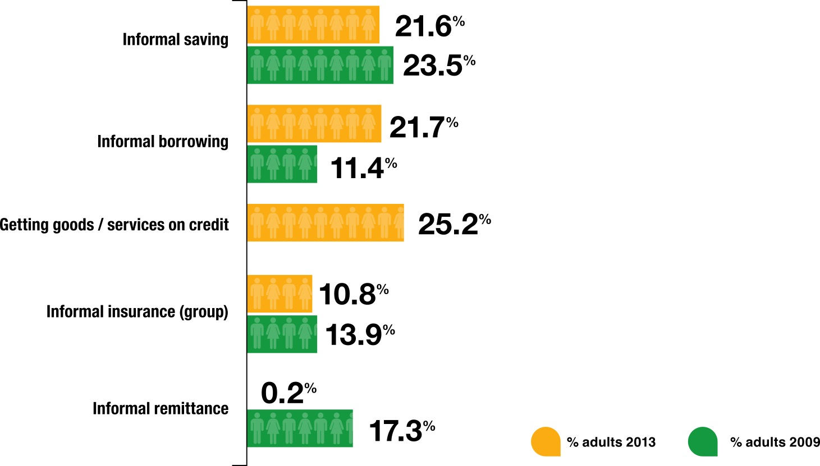
Informal financial service use
Informal borrowing increased; informal remittances decreased

Slide 23
Role of different sectors in the financial system
Banking

Slide 24
Role of different sectors in the financial system
Informal
Informal sector the most likely credit provider

Slide 25
Role of different sectors in the financial system
Non-bank formal

Slide 26
The row of different sectors in the financial system
Informal
Banking
Non-bank formal
Informal sector the most likely credit provider

Slide 27
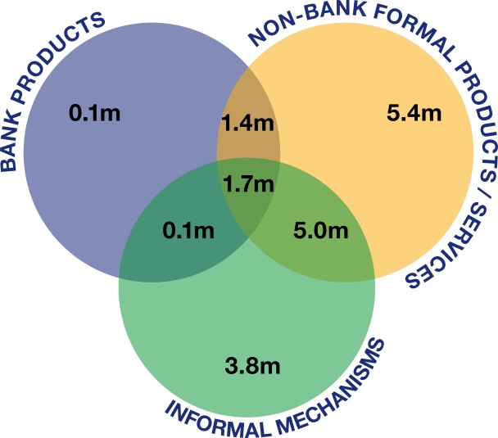
Overlaps in use
Only 100,000 use banks exclusively

Slide 28
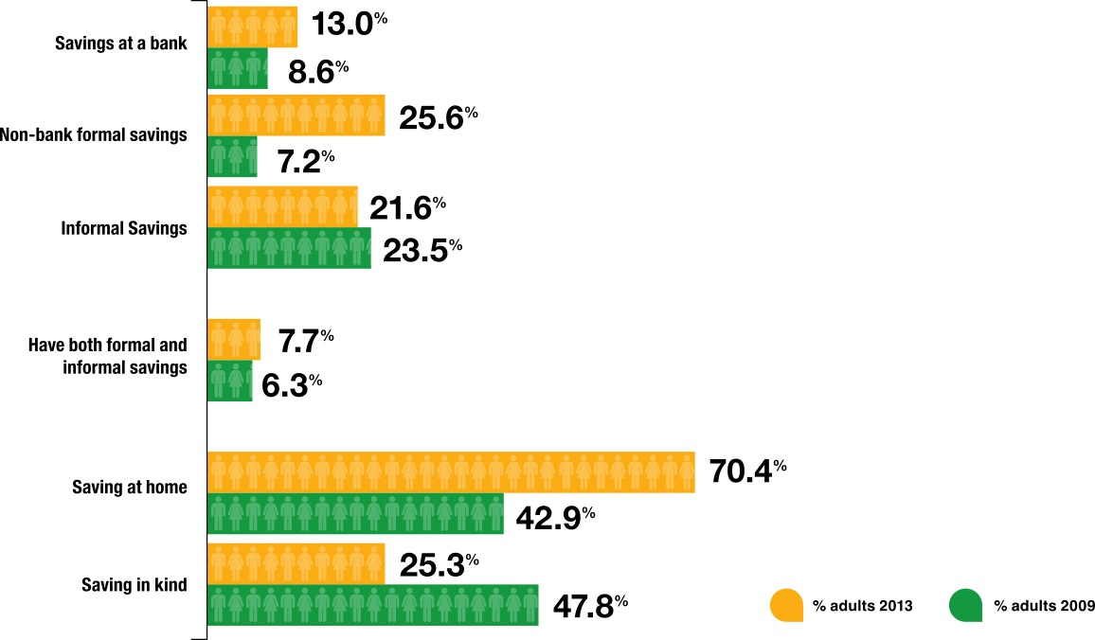
Savings behaviour
Most adults (39%) regard SAVING as “putting money somewhere to stop you from spending it immediately”, rather than as a means of accumulating wealth.
Quick access to money drives choice of savings mechanism (most important driver of choice for 64.9% of claimed savers)
51.7% adults (59.9% of savers, 12.5 m) save for ‘living expenses’

Slide 29
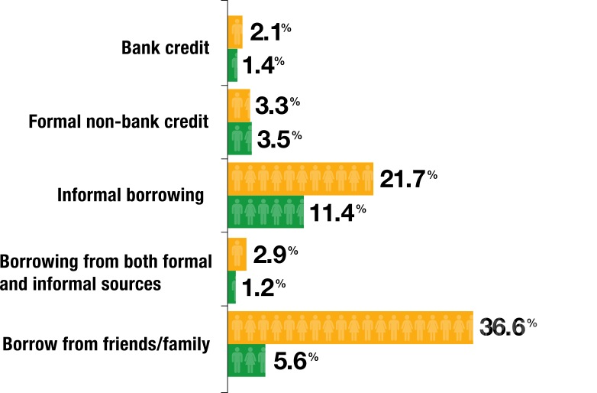
Borrowing behaviour

Slide 30
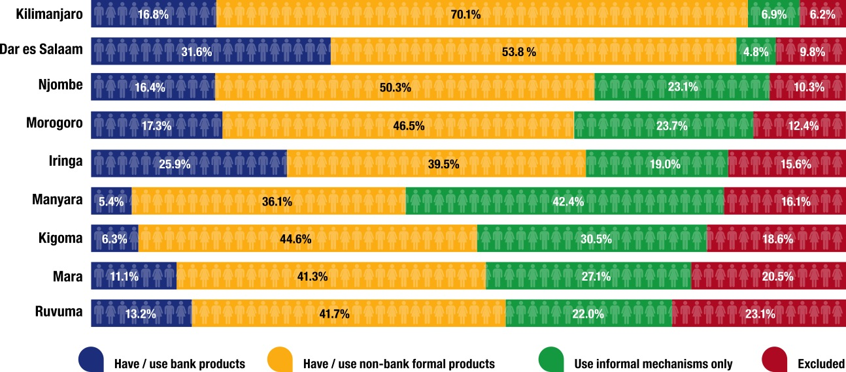
Regions with highest levels of financial inclusion

Slide 31
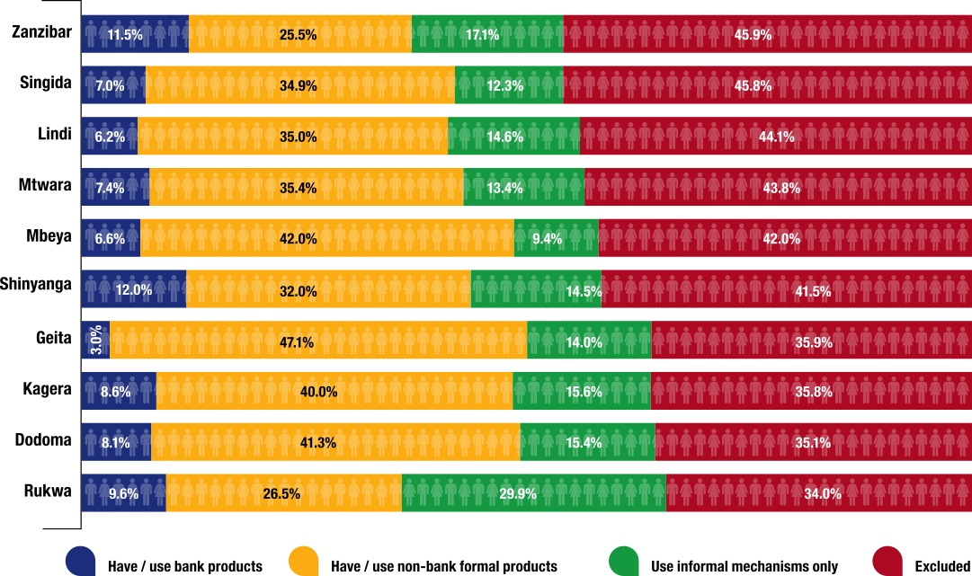
Regions with highest levels of financial exclusion

Slide 32
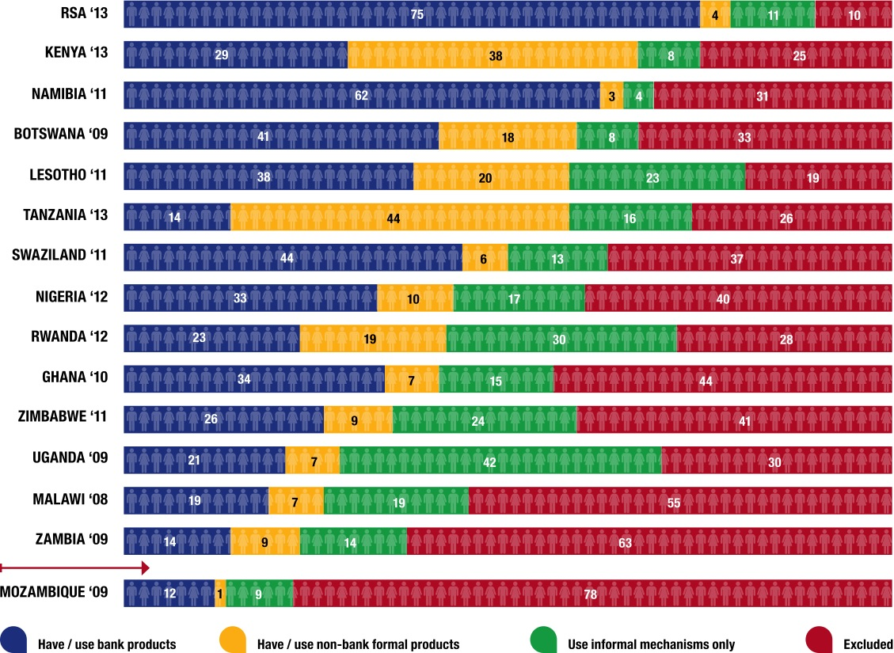
Cross-country comparisons: access strands
(Ranked by level of formal inclusion)
Tanzania access strand adjusted to show 18+ for consistency

Slide 33
Main barriers to uptake
Banking
Mobile money

Slide 34
Insurance products
Credit products
Savings products – main barrier
Insufficient money to cover expenses and still able to put some money away

Slide 35
Key findings
  Significant decrease in EXCLUSION
    11.7m drops to 6.6 m adults financially excluded

Slide 36
Key findings
  Significant decrease in EXCLUSION
    11.7m drops to 6.6 m adults financially excluded
  Usage of mobile money significantly changes landscape of access
    More than half the adult population formally served
    Mobile money mostly used for remittance

Slide 37
Key findings
  Significant decrease in EXCLUSION
    11.7m drops to 6.6 m adults financially excluded
  Usage of mobile money significantly changes landscape of access
    More than half the adult population formally served
    Mobile money mostly used for remittance
  Significant increase in uptake of banking products
    Lagging behind in terms of % adults banked

Slide 38
Key findings
  Significant decrease in EXCLUSION
    11.7m drops to 6.6 m adults financially excluded
  Usage of mobile money significantly changes landscape of access
    More than half the adult population formally served
    Mobile money mostly used for remittance
  Significant increase in uptake of banking products
    Lagging behind in terms of % adults banked
  Significant increase in uptake of health insurance

Slide 39
Key findings
  Significant decrease in EXCLUSION
    11.7m drops to 6.6 m adults financially excluded
  Usage of mobile money significantly changes landscape of access
    More than half the adult population formally served
    Mobile money mostly used for remittance
  Significant increase in uptake of banking products
    Lagging behind in terms of % adults banked
  Significant increase in uptake of health insurance
  Informal sector = Credit provider

Slide 40
THANK YOU

Slide 41
Getting more out of FinScope 2013
Dissemination plan includes…
Tailored analyses and presentations
  Government (incl regional), private sector financial, NGO sector
Newspaper articles and editorials
  The Citizen, Mwananchi,Guardian, Nipashe, Daily News, Habari Leo, Zanzibar Leo
TV discussion and news programmes
  Kipima Joto, MADA, Hoja la Leo, Malumbano ya Hoja, TBC Morning Show and Tuambie, Star TV Jarida Maridhawa, ZBC TV
Radio discussion and news programmes
  East Africa Radio Breakfast Show and Supermix, Clouds FM Power Breakfast, ZBC FM, Coconut FM, Zenji FM
Social media – Twitter and Facebook
Website and blog

Slide 42
Analysis framework

Slide 43
Comparing with Kenya – focus on the effect of mobile money

