Slide 1
Using Data to Pitch Opportunities and Investments
December 2015

Slide 2
Why a pitch isn’t a proposal…
Keep It Simple
Notes:
A pitch is what you use to demonstrate value. A proposal is a detailed plan of how you’re going to meet your objectives.

Slide 3
Why a pitch isn’t a proposal…
Keep It Simple
Keep It SIMPLE
Notes:
A pitch is what you use to demonstrate value. A proposal is a detailed plan of how you’re going to meet your objectives.

Slide 4
Why a pitch isn’t a proposal…
Keep It Simple
Keep It SIMPLE
Tell a Story (demonstrate value)
Notes:
A pitch is what you use to demonstrate value. A proposal is a detailed plan of how you’re going to meet your objectives.

Slide 5
Why a pitch isn’t a proposal…
Keep It Simple
Keep It SIMPLE
Tell a Story (demonstrate value)
Provide KEY information
Notes:
A pitch is what you use to demonstrate value. A proposal is a detailed plan of how you’re going to meet your objectives.

Slide 6
Why a pitch isn’t a proposal…
Keep It Simple
Keep It SIMPLE
Tell a Story (demonstrate value)
Provide KEY information
Quantify where possible
Notes:
A pitch is what you use to demonstrate value. A proposal is a detailed plan of how you’re going to meet your objectives.

Slide 7
Why a pitch isn’t a proposal…
Keep It Simple
Keep It SIMPLE
Tell a Story (demonstrate value)
Provide KEY information
Quantify where possible
Don’t be afraid of what you don’t know
Notes:
A pitch is what you use to demonstrate value. A proposal is a detailed plan of how you’re going to meet your objectives.

Slide 8
Why a pitch isn’t a proposal…
Keep It Simple
Keep It SIMPLE
Tell a Story (demonstrate value)
Provide KEY information
Quantify where possible
Don’t be afraid of what you don’t know
Leave them wanting more
Notes:
A pitch is what you use to demonstrate value. A proposal is a detailed plan of how you’re going to meet your objectives.

Slide 9
Pitching a Product in One Slide…
a value proposition in under 5 minutes

Slide 10
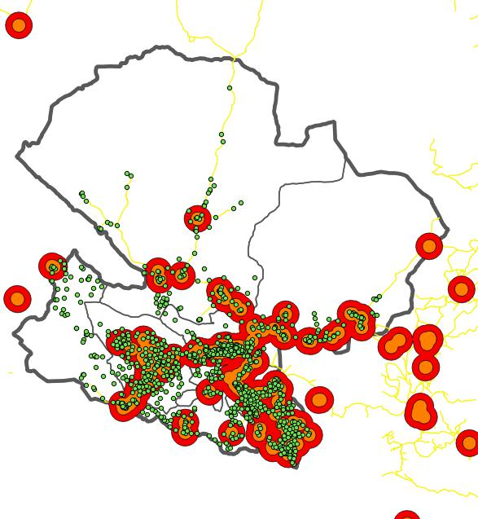
Mbeya – Education Service Point Distribution - 2014
= Education Service Point
All Financial Services 5km, 10km
(excluding Mobile Money)
Mobile Money services
5km, 10km
Notes:
Agency banking
Get new clients: all schools
100 schools: 100 students: 100,000 per year 1billion per year for 1 region for 100 schools 32 regions: 32billion
Develop new product (school fees credit scheme)
Saving schemes for kids
Research why people can’t pay and develop insurance scheme, life/disability insurance, agriculture insurance etc

Slide 11
Pitching an Investment Strategy
don’t be afraid to think big…

Slide 12
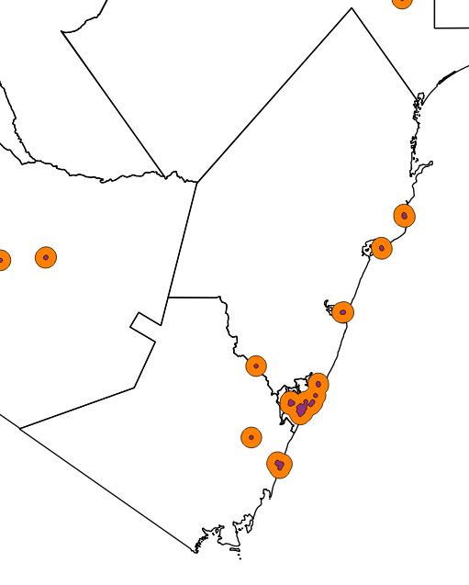
Bank Branch Distribution - 2015
Kilifi
Kwale
Mombasa
Areas 1 km from a bank branch
Areas 5 km from a bank branch

Slide 13
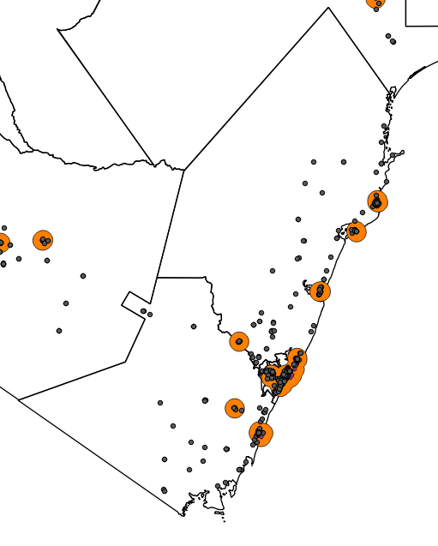
Bank Agent Distribution - 2015
Kilifi
Kwale
Mombasa
45% of Agents are within 1 km of a bank branch
66% of Agents are within 5 km of a bank branch

Slide 14
The Key Information
On average a bank branch has overheads of $2 million per year
45% of our bank agents are within 1km of a branch
Bank agents have an gross cost of $200 in their first year
Counter traffic in our city centre branches has halved
Most branch customers are now high value business clients
Notes:
A pitch is what you use to demonstrate value. A proposal is a detailed plan of how you’re going to meet your objectives.

Slide 15
The Pitch
Close 2 branches in the city centre saving us $4 million per year and sell the properties to raise a further $10 million
Open new business centres in the existing branches located closest to our business customers
Take $10 million and invest in an aggressive expansion of agency banking network in underserved areas
Show an immediate $4 million profit in the balance sheet

Slide 16
Pitching a failure…
why we should love it when things go wrong

Slide 17
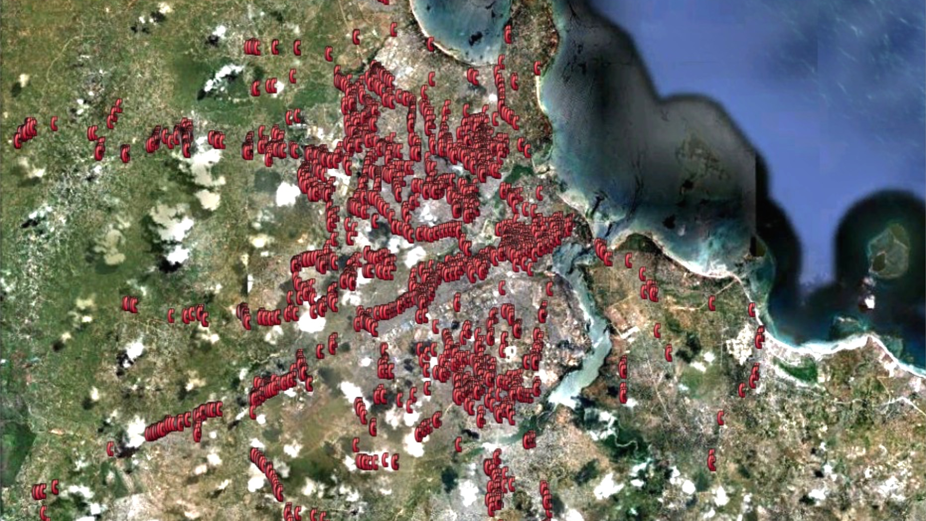
Dar - All Mobile Money Agents

Slide 18
Dar - All Mobile Money Agents

Slide 19
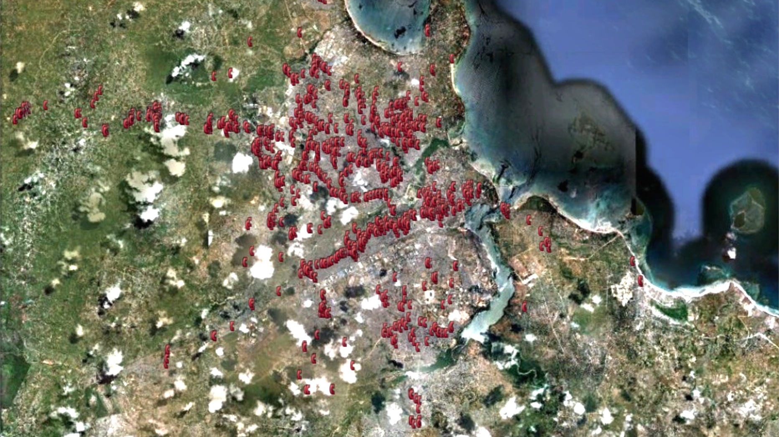
Agents taking over 25 deposits / day

Slide 20
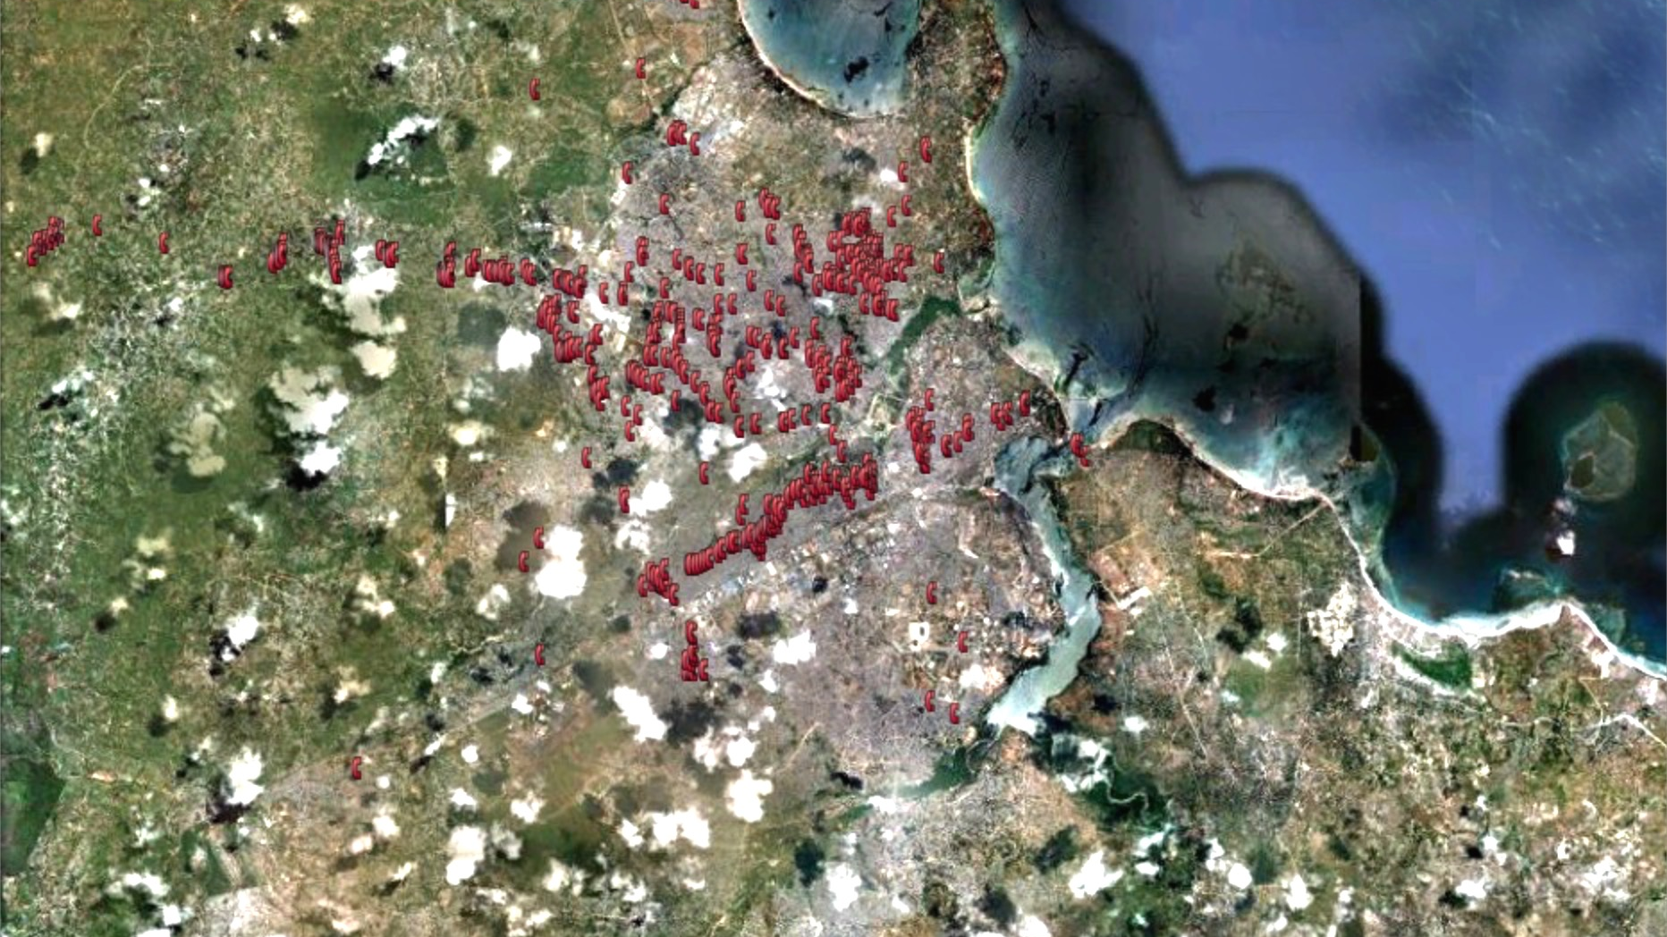
Agents taking over 50 deposits / day

Slide 21
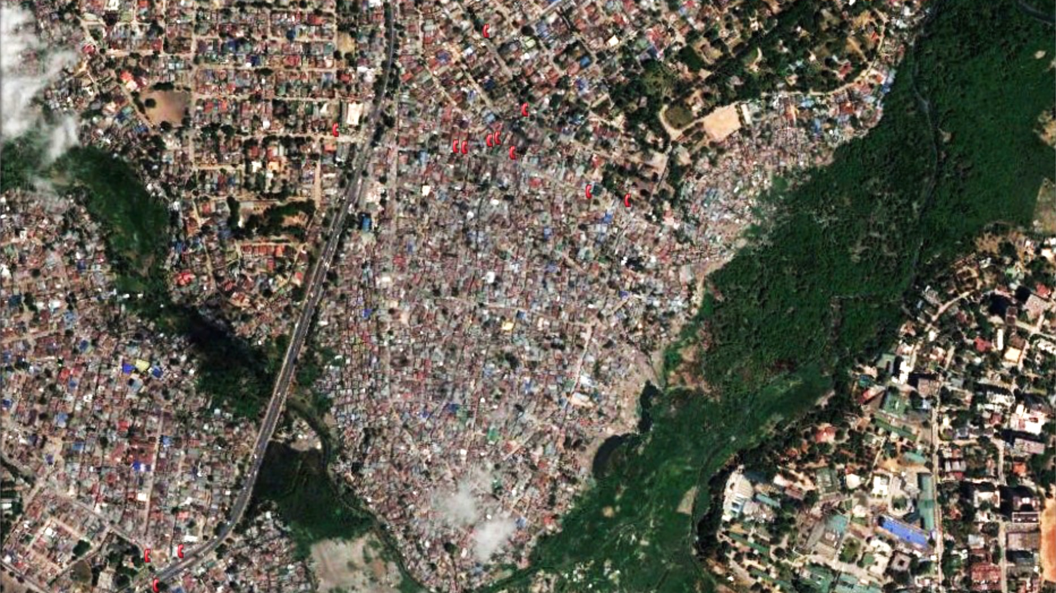
Low income area

Slide 22
Better questions can be as valuable as new products
Why do we see agents but no transactions?
How does this affect our current investment in mobile money agents?
Can we find a way for existing products to more appropriate?
Can we develop a new product to better serve these customers?

Slide 23
david@usabledata.co

