Slide 1
Using Data to Develop and Target New Products
December 2015

Slide 2
New ways to understand your market
the power of maps over tables

Slide 3
Dar - All Mobile Money Agents

Slide 4
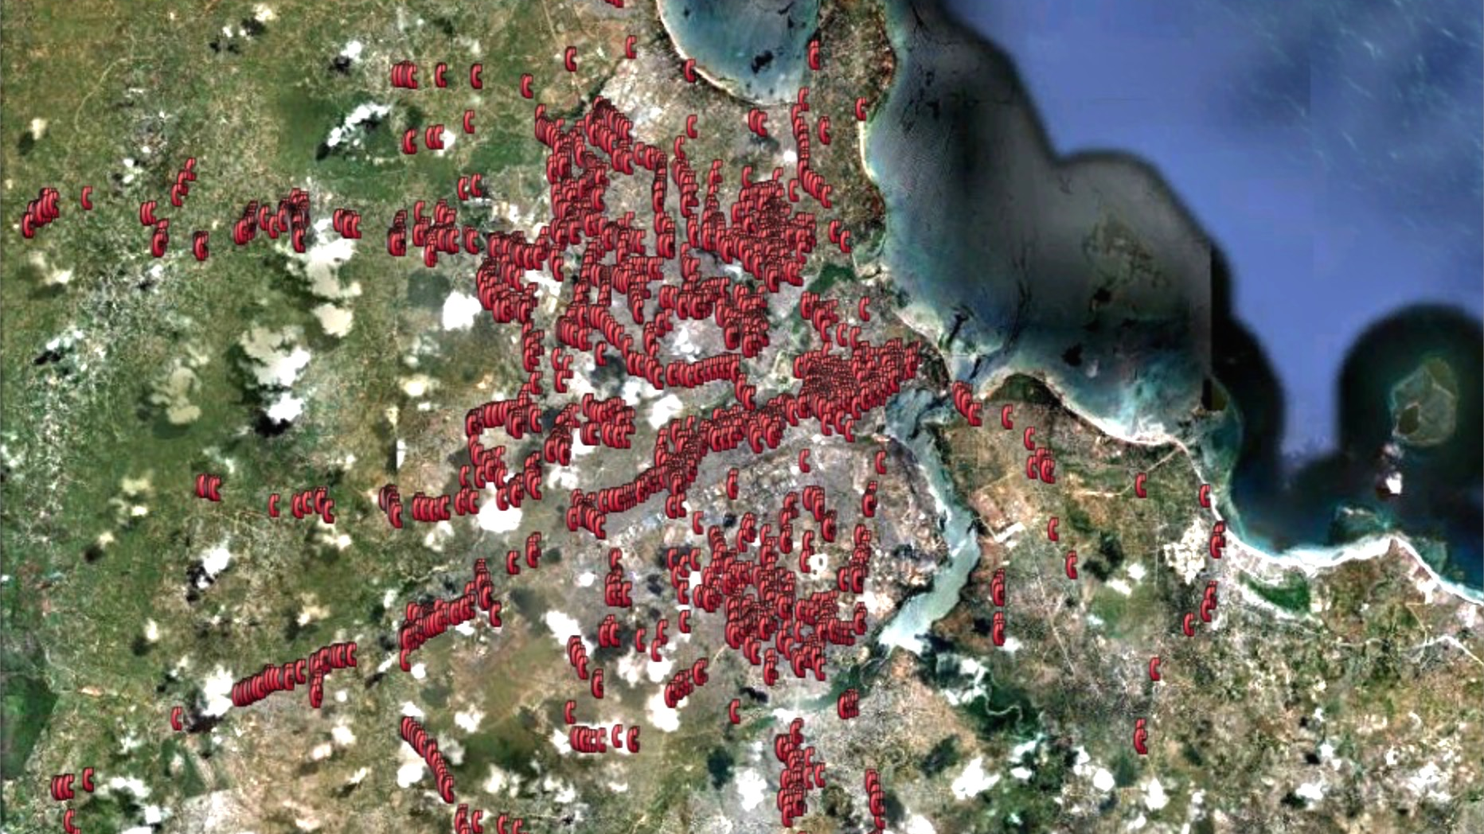
Dar - All Mobile Money Agents

Slide 5
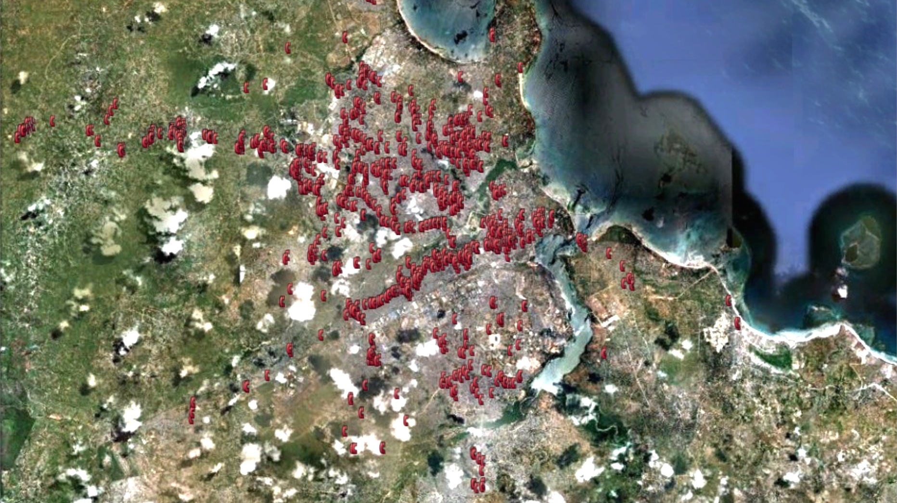
Agents taking over 25 deposits / day

Slide 6
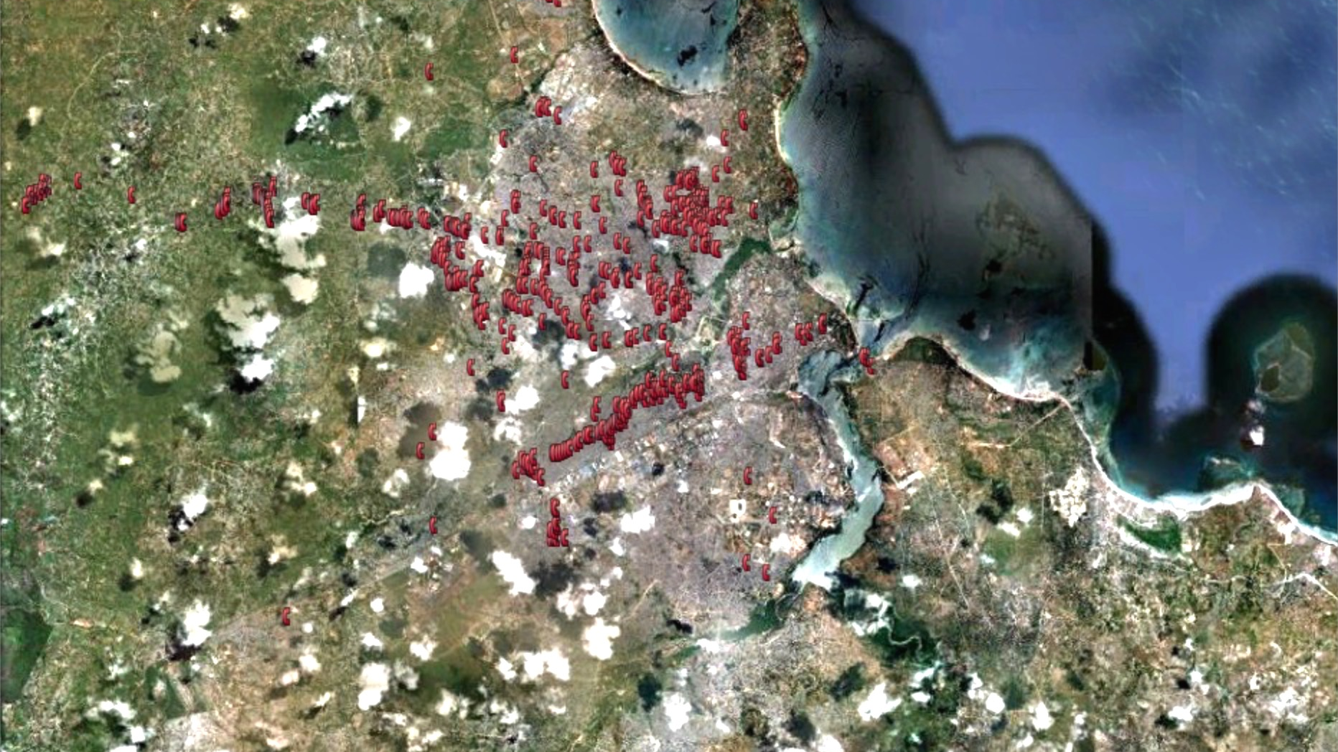
Agents taking over 50 deposits / day

Slide 7
An Interesting Pattern

Slide 8
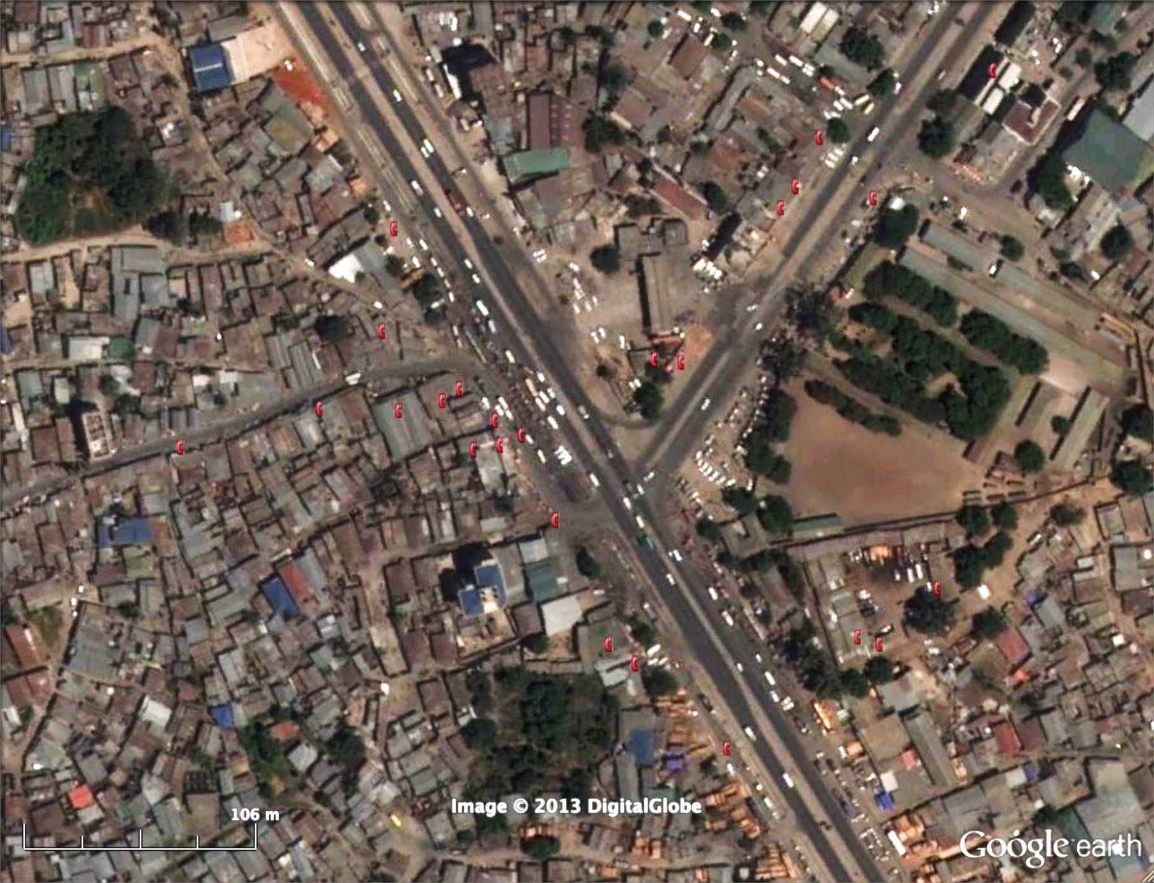
An Interesting Pattern
Notes:
11 agents within 100m in the top 10% of number of deposits for the city

Slide 9
What is driving the market?
Notes:
Being driven by business not consumers? Are there new products which can be sold to business customers?
New Questions: what kinds of business are they doing? Are there other services which they need or existing systems which could be made simpler.
Is this an area which banks should be targeting with the expansion of bank agents?

Slide 10
Understanding Market Growth
adventures in time and space

Slide 11
The expansion of the Commercial Banks

Slide 12
The Power of Outliers
don’t just look for answers, look for better questions

Slide 13
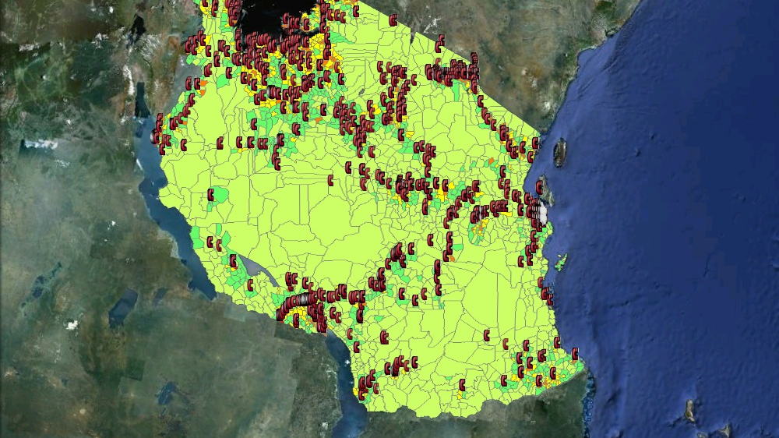
Agent Liquidity Management

Slide 14
Agent Liquidity Management

Slide 15
Agent Liquidity Management

Slide 16
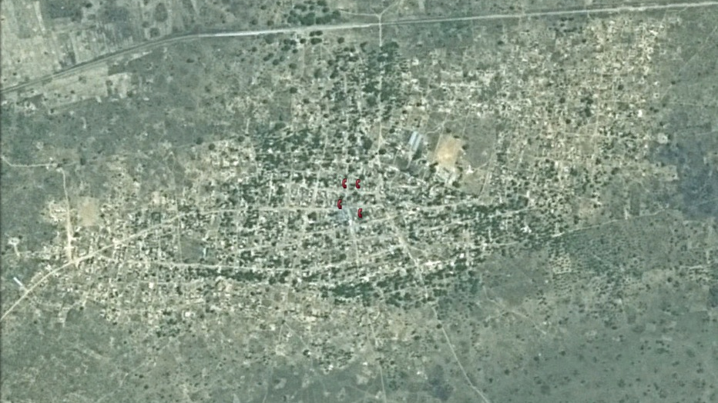
Agent Liquidity Management
Notes:
4 agents all doing a high number of transactions. Over 80km from nearest bank

Slide 17
Agency Banking Model
financial inclusion or supporting existing infrastructure

Slide 18
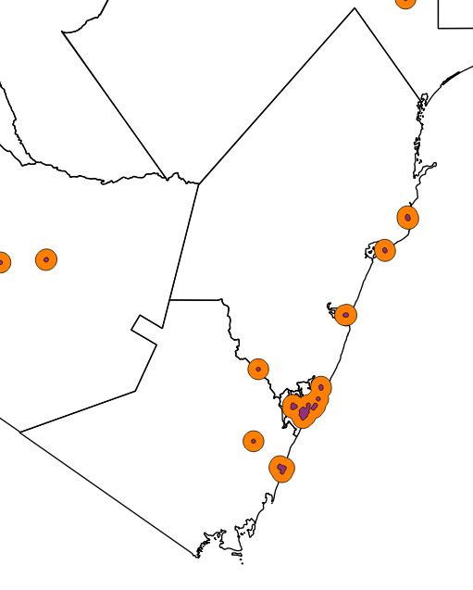
Bank Branch Distribution - 2015
Kilifi
Kwale
Mombasa
Areas 1 km from a bank branch
Areas 5 km from a bank branch

Slide 19
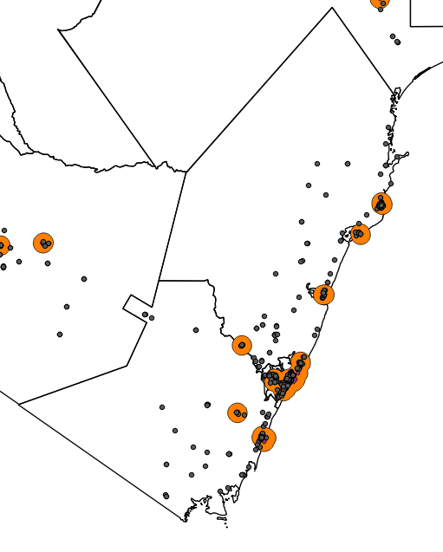
Bank Agent Distribution - 2015
Kilifi
Kwale
Mombasa
45% of Agents are within 1 km of a bank branch
66% of Agents are within 5 km of a bank branch

Slide 20
Agriculture Analysis

Slide 21
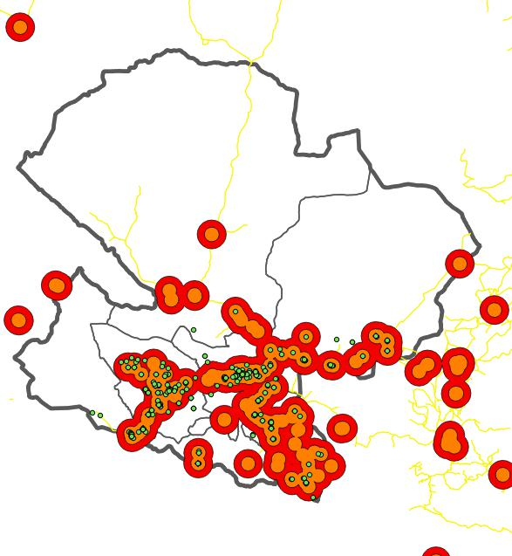
Mbeya - Agriculture Point Distribution - 2014
= Agriculture Service Point
All Financial Services 5km, 10km
(excluding Mobile Money)
Mobile Money services
5km, 10km

Slide 22
% of Agricultural Input Agent Sub Branches within 5 and 10 km of Financial Services
District | All Fin Access Points |  | All Fin Access Points (exc Mobile Money) |  | Commercial Banks |  | Micro Finance Institutions |  | Mobile Money Agents
 | 5km | 10km | 5km | 10km | 5km | 10km | 5km | 10km | 5km | 10km
Chunya | 50% | 50% | 50% | 50% | 50% | 50% | 50% | 50% | 50% | 50%
Ileje | 100% | 100% | 100% | 100% | 32% | 100% | 0% | 0% | 100% | 100%
Kyela | 100% | 100% | 100% | 100% | 77% | 82% | 68% | 73% | 95% | 100%
Mbarali | 93% | 93% | 66% | 86% | 0% | 0% | 14% | 45% | 93% | 93%
Mbeya Rural | 81% | 95% | 56% | 91% | 49% | 56% | 9% | 65% | 81% | 91%
Mbeya Urban | 100% | 100% | 98% | 100% | 59% | 91% | 89% | 100% | 100% | 100%
Mbozi | 84% | 95% | 66% | 78% | 11% | 28% | 11% | 28% | 84% | 95%
Momba | 89% | 89% | 89% | 89% | 0% | 84% | 0% | 0% | 89% | 89%
Rungwe | 100% | 100% | 100% | 100% | 24% | 46% | 24% | 46% | 93% | 93%
Tunduma | 100% | 100% | 100% | 100% | 96% | 100% | 0% | 0% | 100% | 100%
Total | 91% | 97% | 80% | 90% | 32% | 53% | 29% | 47% | 91% | 95%
Notes:
----- Meeting Notes (28/10/15 12:50) -----
Economic Growth
Liquidity

Slide 23
Education Point Analysis

Slide 24
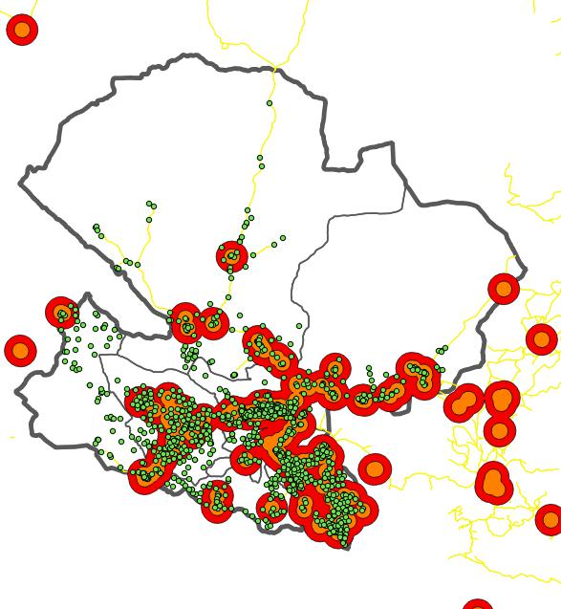
Mbeya – Education Service Point Distribution - 2014
= Education Service Point
All Financial Services excluding Mobile Money 5km, 10km
Mobile Money services
5km, 10km

Slide 25
Medical Point Analysis

Slide 26
Mbeya – Medical Service Point Distribution - 2014
= Medical Service Point
All Financial Services excluding Mobile Money 5km, 10km
Mobile Money services
5km, 10km

Slide 27
Data combined
integrating financial access into the real world

Slide 28
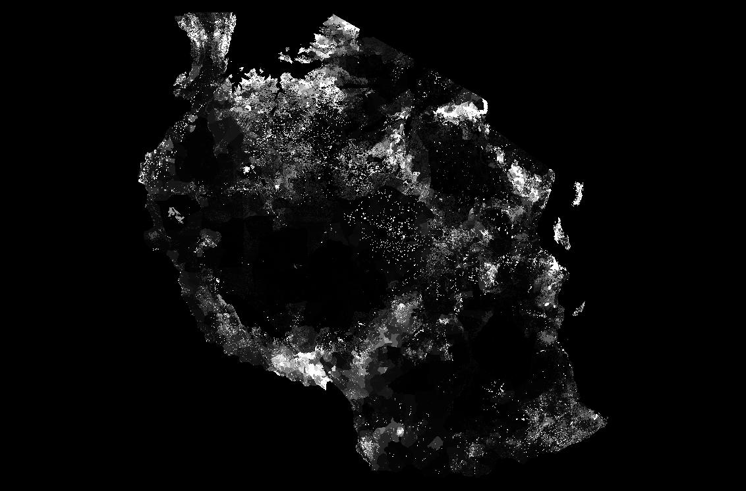
Understanding where people are…
Population density
www.worldpop.org

Slide 29
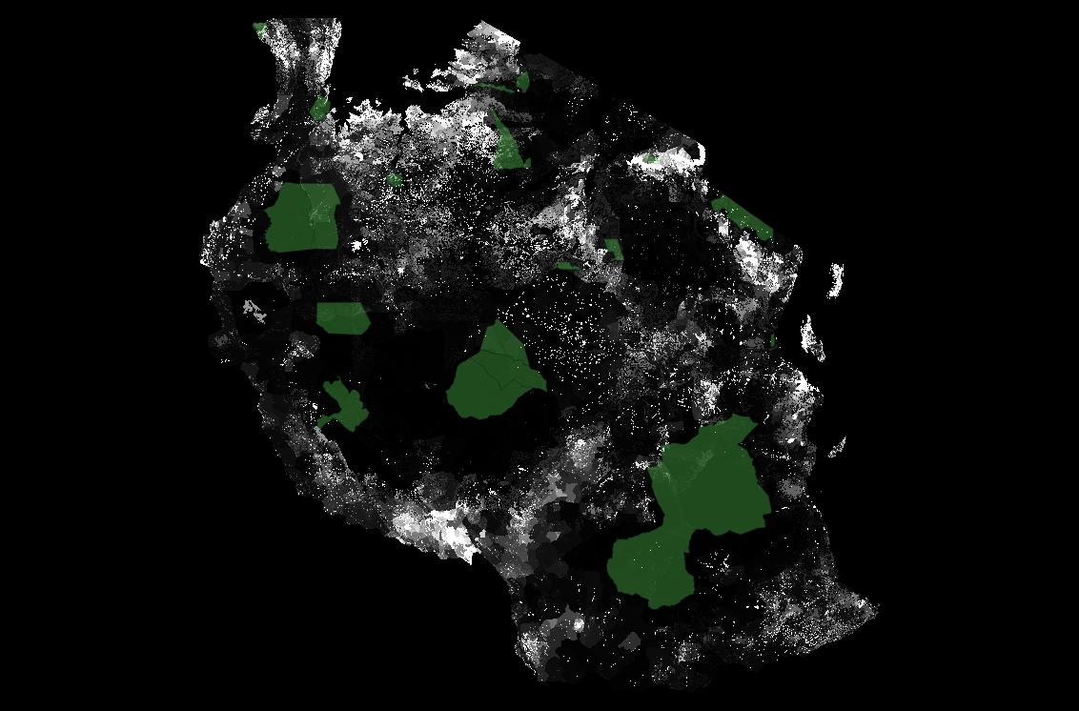
Why people are where they are…
Game Reserves
Population density
Population density
www.worldpop.org

Slide 30
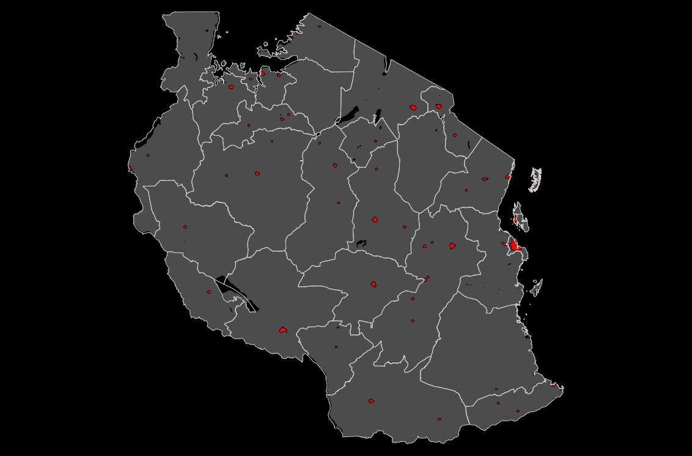
Understanding which people are where…
Rural / Urban Divide
GRUMP

Slide 31
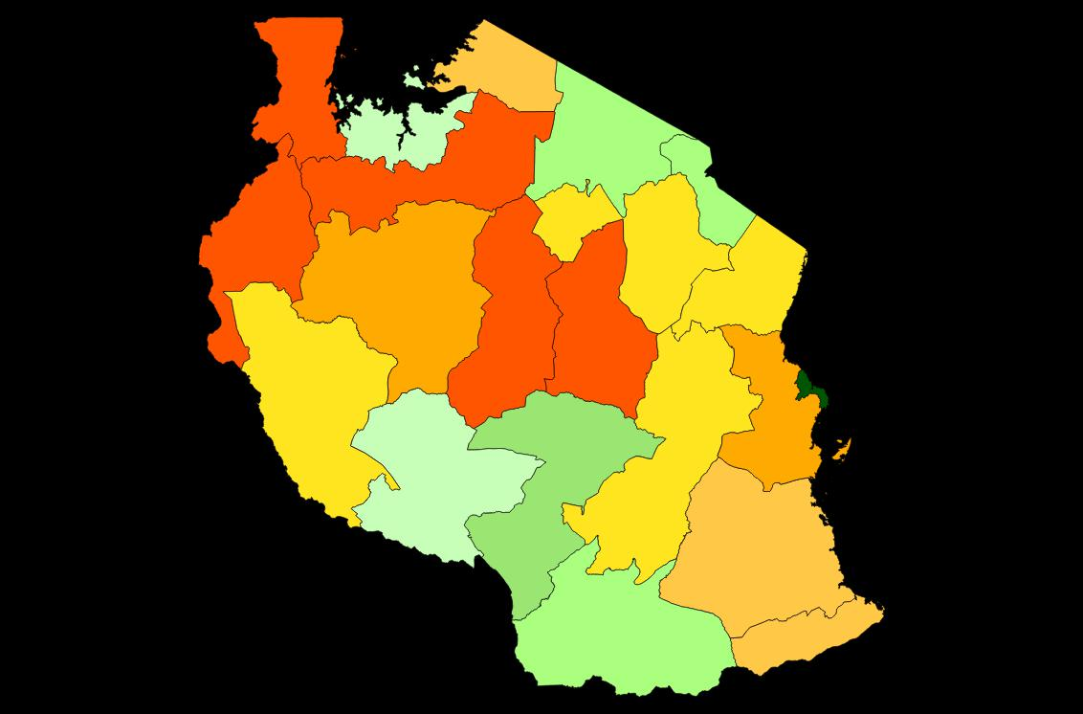
Understanding which people are where…
Around 1 Million Tsh
Under 600,000 Tsh
Over 1.5 Million Tsh
Between 600,000 and 1 Million Tsh
Per Capita GDP 2011
National Bureau of Statistics Tanzania

Slide 32
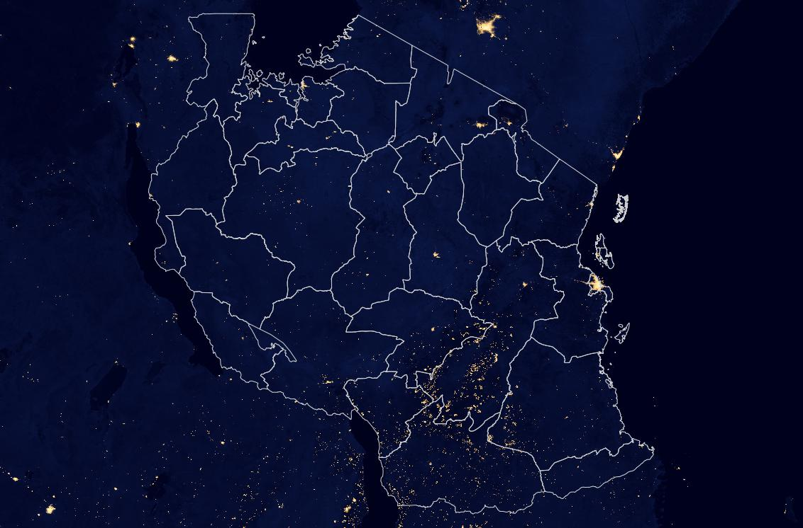
Understanding where services are…
Electricity use:
Lights at night
NASA

Slide 33
Potential Datasets Which could be combined
your strategy ➔ your data…
transaction volumes
customer profiles
liquidity
performance metrics
service provision

Slide 34
david@usabledata.co

