Slide 1
Insights for Ideas
BRAVE
VENTURE LABS

Slide 2
Human Centered Design
A process for understanding people and designing solutions to their problems.

Slide 3
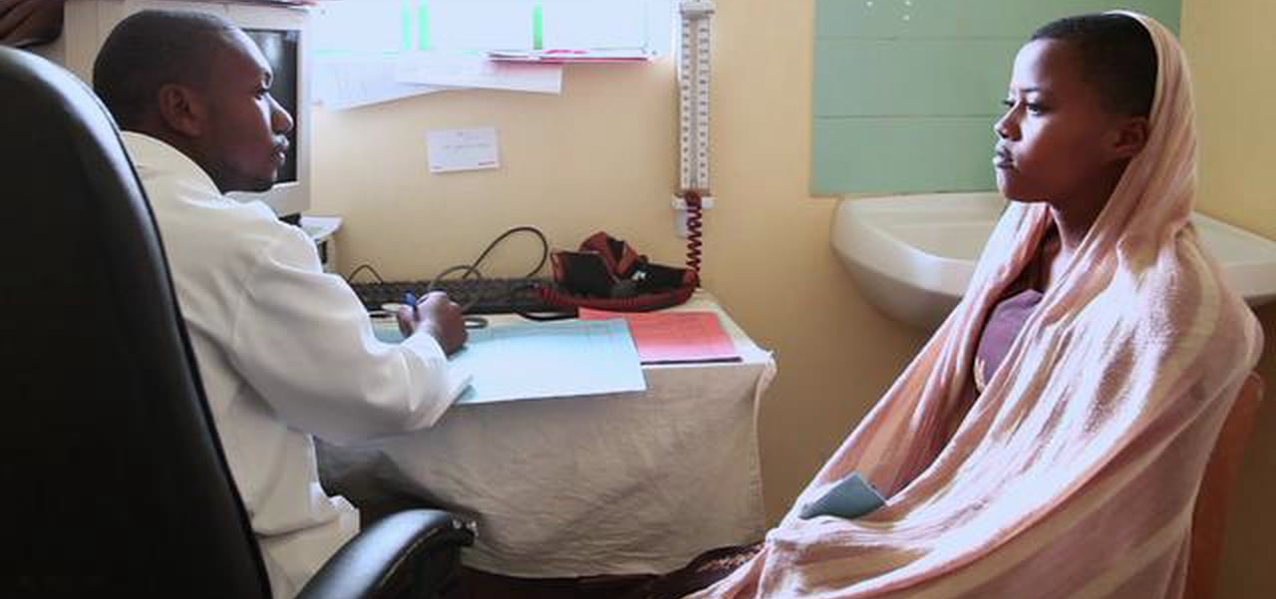

Slide 4
Exercise
Design a Ladder

Slide 5
Empathy
Stepping outside of your life and seeing the world from someone else’s viewpoint.

Slide 6
How do you gain empathy for someone?

Slide 8
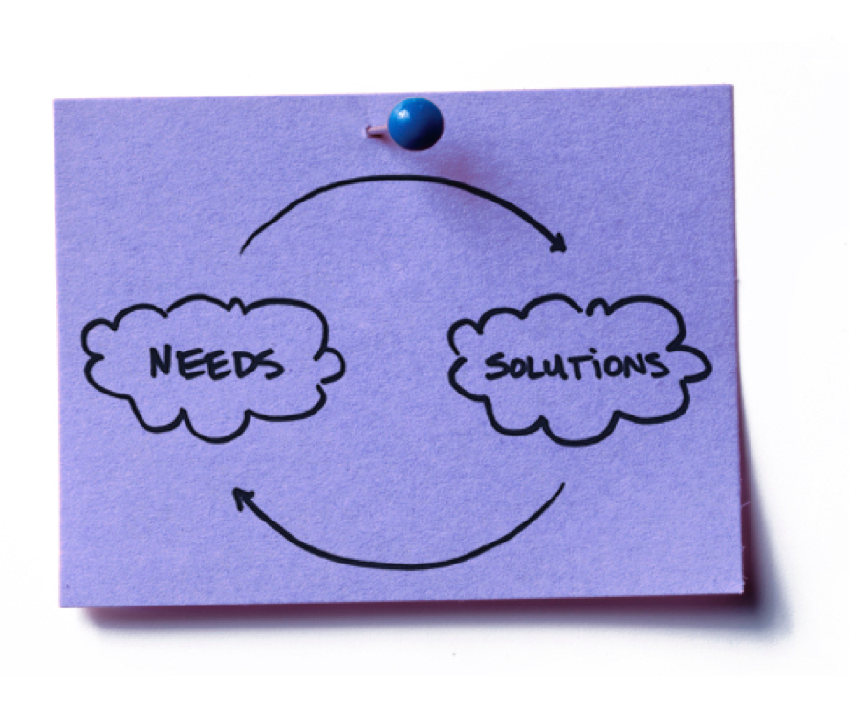

Slide 9
need \’ned\ 1 : a physical, metal or social reqirement of a person or group.
2 : something I want to do, think or feel.
solution \se-’lü-shen\ 1 : an object, action or process that satisfies a need.

Slide 10
VERB
need \’ned\ 1 : a physical, metal or social reqirement of a person or group.
2 : something I want to do, think or feel.
solution \se-’lü-shen\ 1 : an object, action or process that satisfies a need.
NOUN

Slide 11
VERB I need to clean my teeth.
need \’ned\ 1 : a physical, metal or social reqirement of a person or group.
2 : something I want to do, think or feel.
solution \se-’lü-shen\ 1 : an object, action or process that satisfies a need.
NOUN
…with a toothbrush.

Slide 13
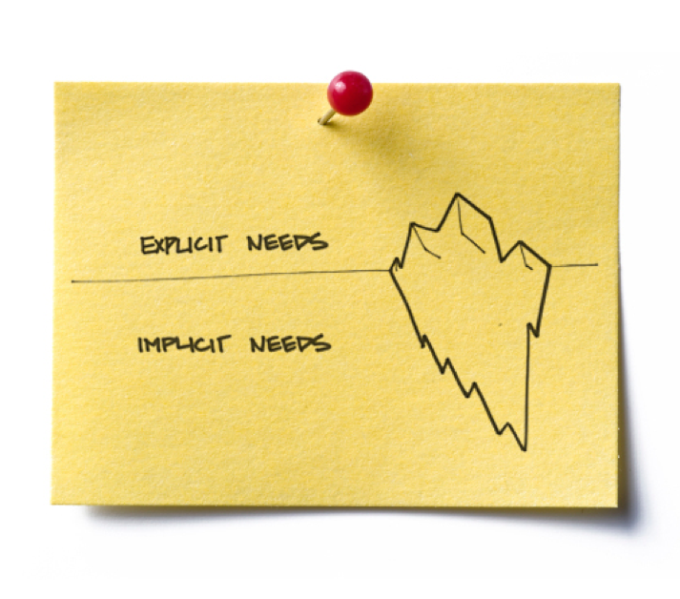
Not all needs are directly observable.

Slide 14
How do you find needs you can’t easily see?

Slide 15
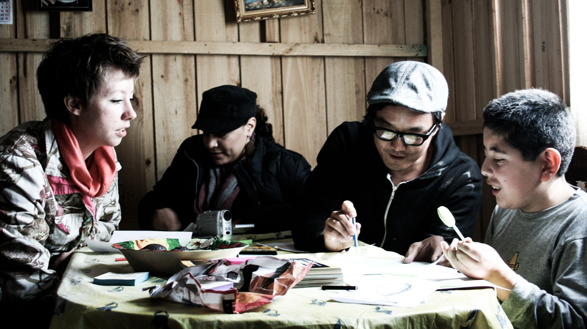
Exercise
Ask, Answer, Watch

Slide 16
Exercise
Ask, Answer, Watch
Topic
“Tell me about the last time you saved for something.”

Slide 17
What did you learn?

Slide 18
Ways to build empathy.
1. Be open to seeing their world from their point of view.
2. Let the them lead.
3. Talk 10%, listen 90%.
4. Ask open ended questions to solicit stories.
5. Follow up on personal and concrete topics
6. Use the words they use.
7. Be warm and interested. Smile.

Slide 19
To design your research you’ll need…
Users
Themes
Methods
Extremes
Might tell you the most about furture trends
Mainsteam
Might be your core customer
Values
What life choices and decisions explain their beliefs and preferences
Behaviors
What activities do they do that might reveal needs for support
Interviews
Ask the broad and specific questions to learn about their life
Observations
Watch them do something to reveal how they think

Slide 20
To design your research you’ll need…
Users
Themes
Methods
Extremes
Might tell you the most about furture trends
Mainsteam
Might be your core customer
Values
What life choices and decisions explain their beliefs and preferences
Behaviors
What activities do they do that might reveal needs for support
Interviews
Ask the broad and specific questions to learn about their life
Observations
Watch them do something to reveal how they think
We’ve given you a few to choose from.
Try drawing out themes from ask, answer, watch.
Try an interview + one other technique.

Slide 21
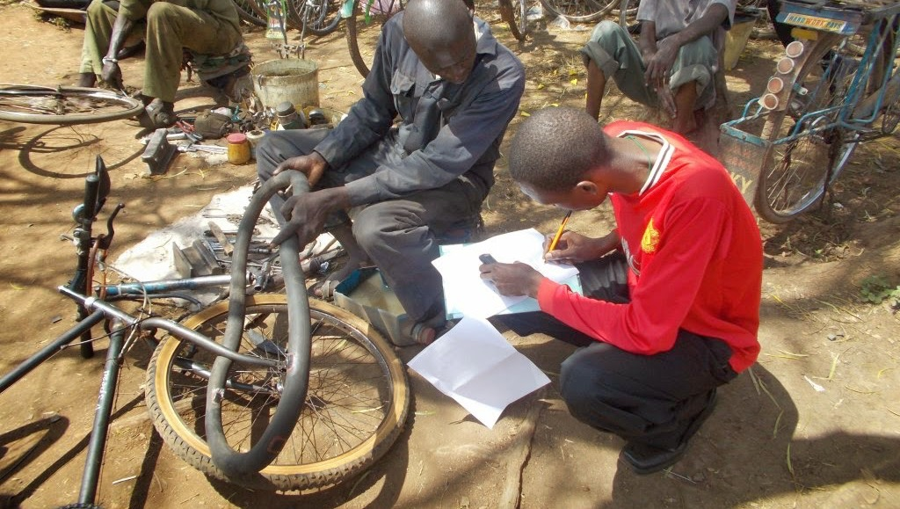
Exercise
Design your Research

Slide 22
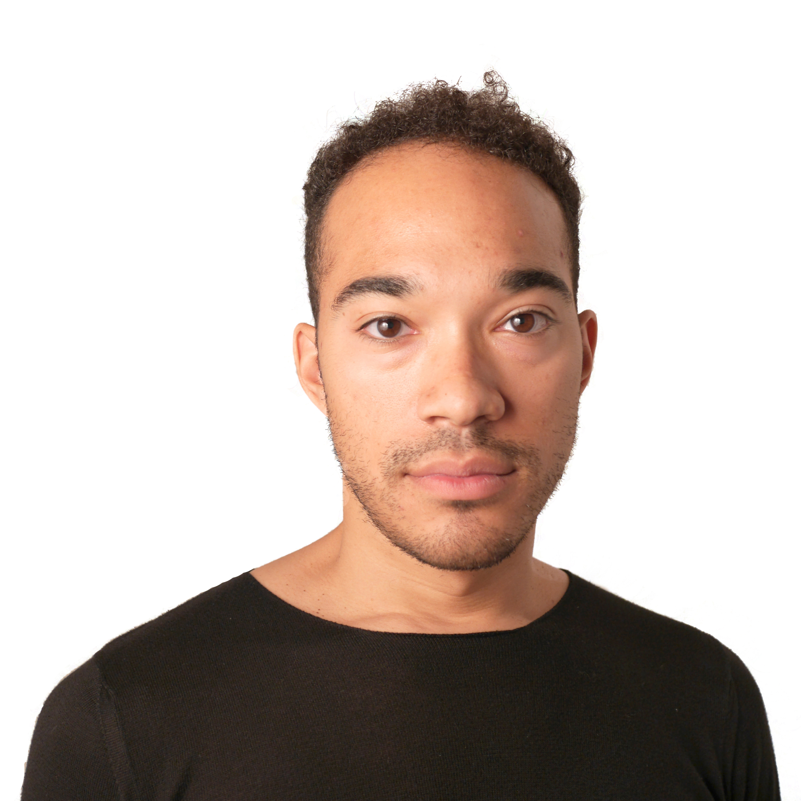
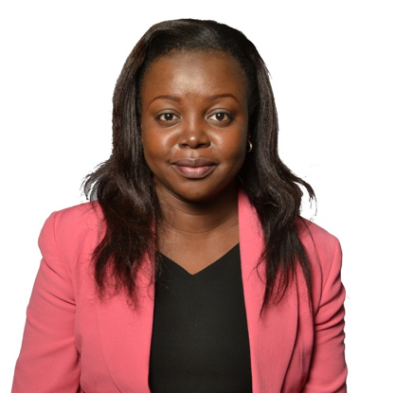
BRAVE
VENTURE LABS
Ibanga Umanah
ibanga@braveventurelabs.com
@ibangaumanah
Jessica Colaco
jessica@braveventurelabs.com
@jessicacolaco
Lilian Mukabane
lilian@braveventurelabs.com
@lily_mukabane

Slide 23
Insights for Ideas
BRAVE
VENTURE LABS

Slide 24
Innovation
A new idea or process for addressing a problem.

Slide 26
Where do innovations come from?
Challenging Orthodoxies
Overturn deeply held and broadly shared conventions within an industry.
Harnessing Trends
Recognize and exploit a culster of technological, social, and economic trends that could change the rules of an industry.
Understanding Customer Needs
Listen and learn about how the customer’s goals could be better reached.
Utilizing Competencies
Recognize opportunity for a company based on what it knows how to do, not just what it delivers today.

Slide 27
Where do innovations come from?
Challenging Orthodoxies
Overturn deeply held and broadly shared conventions within an industry.
Harnessing Trends
Recognize and exploit a culster of technological, social, and economic trends that could change the rules of an industry.
Understanding Customer Needs
Listen and learn about how the customer’s goals could be better reached.
Utilizing Competencies
Recognize opportunity for a company based on what it knows how to do, not just what it delivers today.

Slide 28
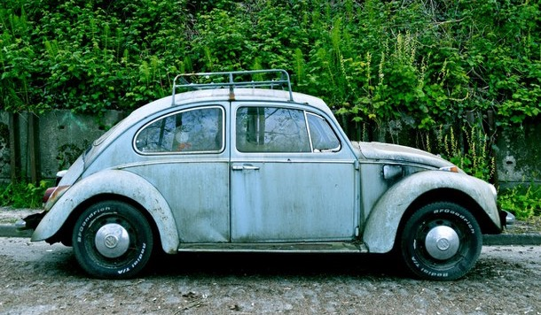
Exercise
List 10 orthodoxies in your business.

Slide 29
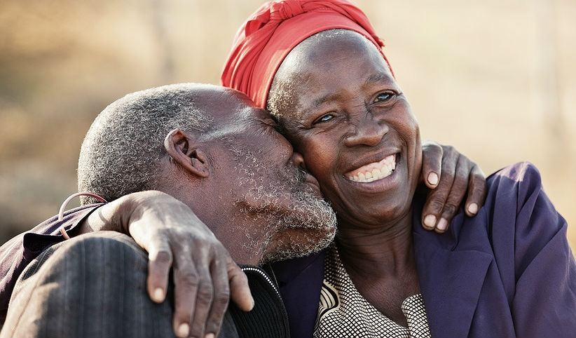
Exercise
List 10 unmet needs you’ve uncovered so far.

Slide 30
What did you learn?

Slide 31
Prototype
A representation of a part of your business that you can walk a user through.

Slide 33
Learn.
Faster
Safer
Cheaper
Smarter
Easier

Slide 34
Rapid Prototyping
The practice of building just enough to evaluate a specific element of the idea, then immediately refining the idea based on feedback.

Slide 35
Exercise
Prototype your ideas

Slide 36
Experiment
A controlled test of a critical business question to refine the offering.

Slide 37
Experiment to build faster and cheaper.
Pilot
Experiment
One cycle
Iterative cycles
Multivariable data
Singular variable data
Long period
Short period
Clear, static offeirng
Continuously updating offering
Informs large investment decisions
Informs the next investment decision

Slide 38
Experiment towards...
Desirability
Feasibility
People can use it and like it
You can build and scale it
Viability
People sign up and pay for it

Slide 39
Experiment in this order.
1. Desirability
2. Viability
3. Feasibility
People can use it and like it
People sign up and pay for it
You can build an scale it
Qualified Interest
Revenue
Positive Cash Flow
User Experience
Price and Marketing
Development and Distribution

Slide 40
Define what’s most uncertain.
1. Desirability
2. Viability
3. Feasibility
Who’s the first customer?
How do people learn about it?
Can we build it cheaply?
Why do they decide to try?
How much will people pay?
Are our partners capable?
Can people operate it?
Is the market big enough?
Is the ROI worth pursuing?

Slide 41
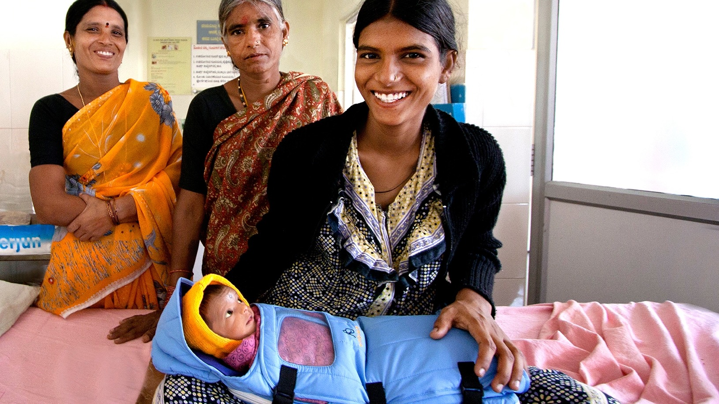
Exercise
Design your test

Slide 42
BRAVE
VENTURE LABS
Ibanga Umanah
ibanga@braveventurelabs.com
@ibangaumanah
Jessica Colaco
jessica@braveventurelabs.com
@jessicacolaco
Lilian Mukabane
lilian@braveventurelabs.com
@lily_mukabane

