Slide 1
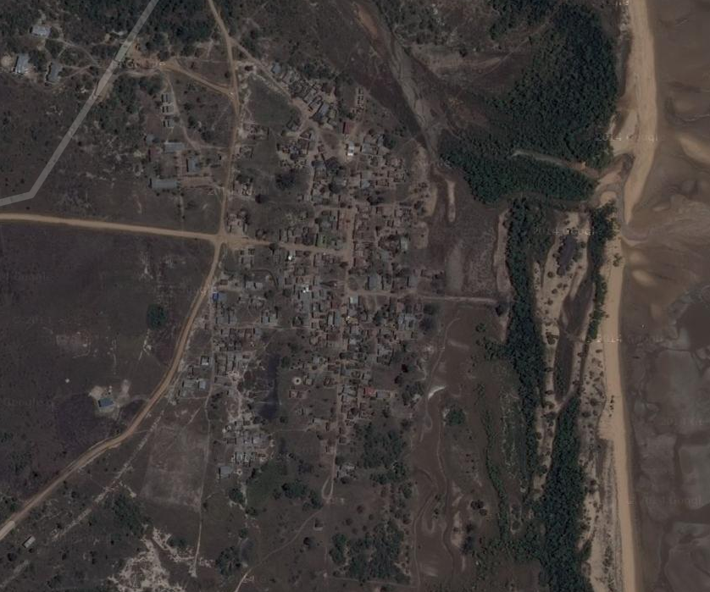
KIJIJI CHA SAADANI
KILOMETA ZA MRABA 1100 AMBAZO NI HIFADHI YA TAIFA NA MAKAZI YA WATU

Slide 2
HISTORIA NA UTAFITI
Kijjiji cha Saadani kina wakazi kati ya 630 na 650 wanafoanya shughuli za uvuvi, uvunaji chumvi, biashara ndogo ndogo na kilimo cha wastani.
CHANGAMOTO ZILIZOPO
Njia rahisi ya kutunza pesa zao kidogo kidogo.
Upatikanaji wa fedha za ada kwa wakati mmoja.
MATARAJIO
Njia rahisi ya utunzaji wa fedha zao kidogo kidogo
Uwezo wa kupata fedha za ada kwa mkupuo mmoja

Slide 3
WEKEZA NA SOMESHA NA AIRTEL
Pata mkopo rahisi na somesha na Airtel Money
Wekeza sasa na Airtel Money uweze kusomesha watoto na kuweka akiba ya badae kwa maendeleo yako
Piga *889*68#
1.Tuma pesa
2.Toa pesa
3.Wekeza na Somesha 1. Wekeza Kiasi
2.Somesha Chukua Mkopo
4.Akaunti yangu
WEKEZA – Waweza wekeza kiasi chochote ambacho bila makato wakati wa
kutoa.
SOMESHA – Utapata mara mbili ya kiwango ulicho wekeza kwa ajili ya kusomesha, Ambacho kitakatwa kwenye kiwango ambacho
utarejesha kadri unavyoendelea kuwekeza.

Slide 4
VALUE PROPOSITIONS
Long term savings without costs
Easy way to use on Basic phones
Easy way to get unsecured loans
CUSTOMER SEGMENTS
Low income earners who currently don’t do any savings.
Individuals who can’t afford to have accumulated money for school fees
CHANNELS
Basic mobile phones
MNO’s Agents.
Advertisements and awareness
CUSTOMER RELATIONSHIPS
MNO’s Agents.
Self service

Slide 5
KEY PARTNERS.
Financial Institutions
MNO’s
KEY ACTIVITIES
Product design
Identification of key stakeholders.
Integration and testing
Launching the product.
KEY RESOURCES.
Software Developers.
Capital.
COST STRUCTURE
Intergration
Marketing and advertisement.
Product development cost.

Slide 6
REVENUE STREAMS
Interest from deposits in the bank.
MNO’s new gross adds

Slide 7
THANK YOU

