Slide 1
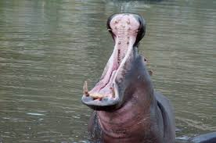
Hello!
Team Kiboko
athu daniel eli erica kelvin sarah

Slide 2
Biashara App

Slide 3
Panga Biashara, Pata Zaidi

Slide 4
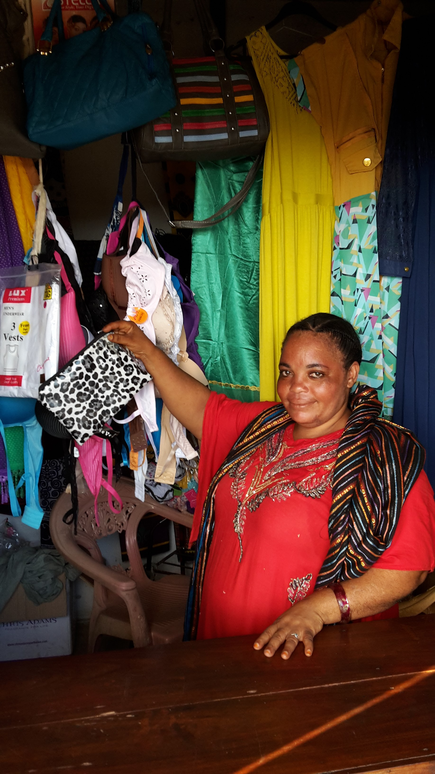
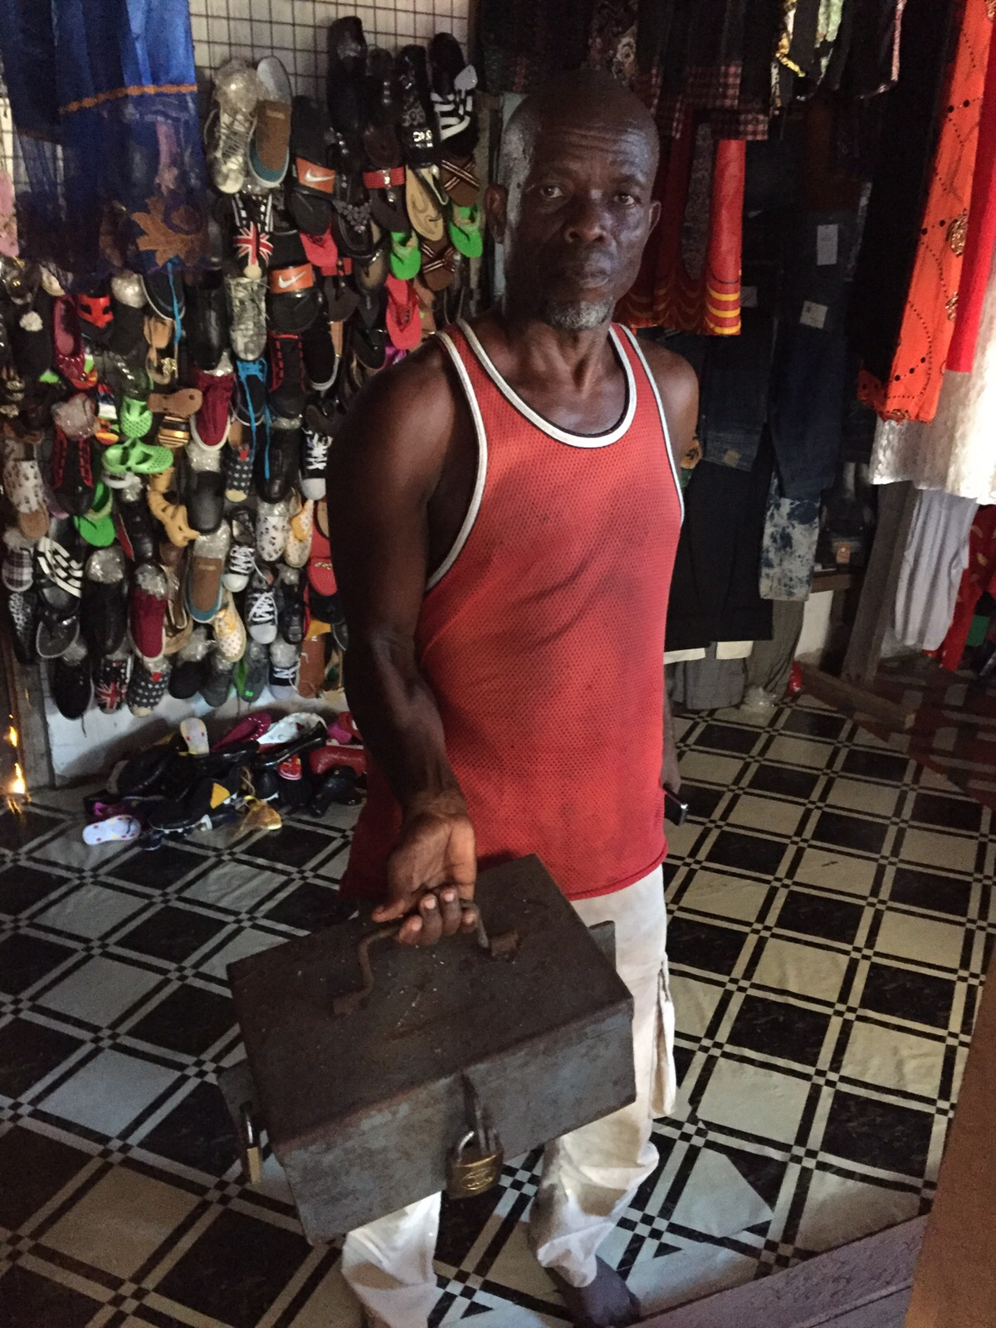
Rahisi
Gharama nafuu
Mahali popote

Slide 5
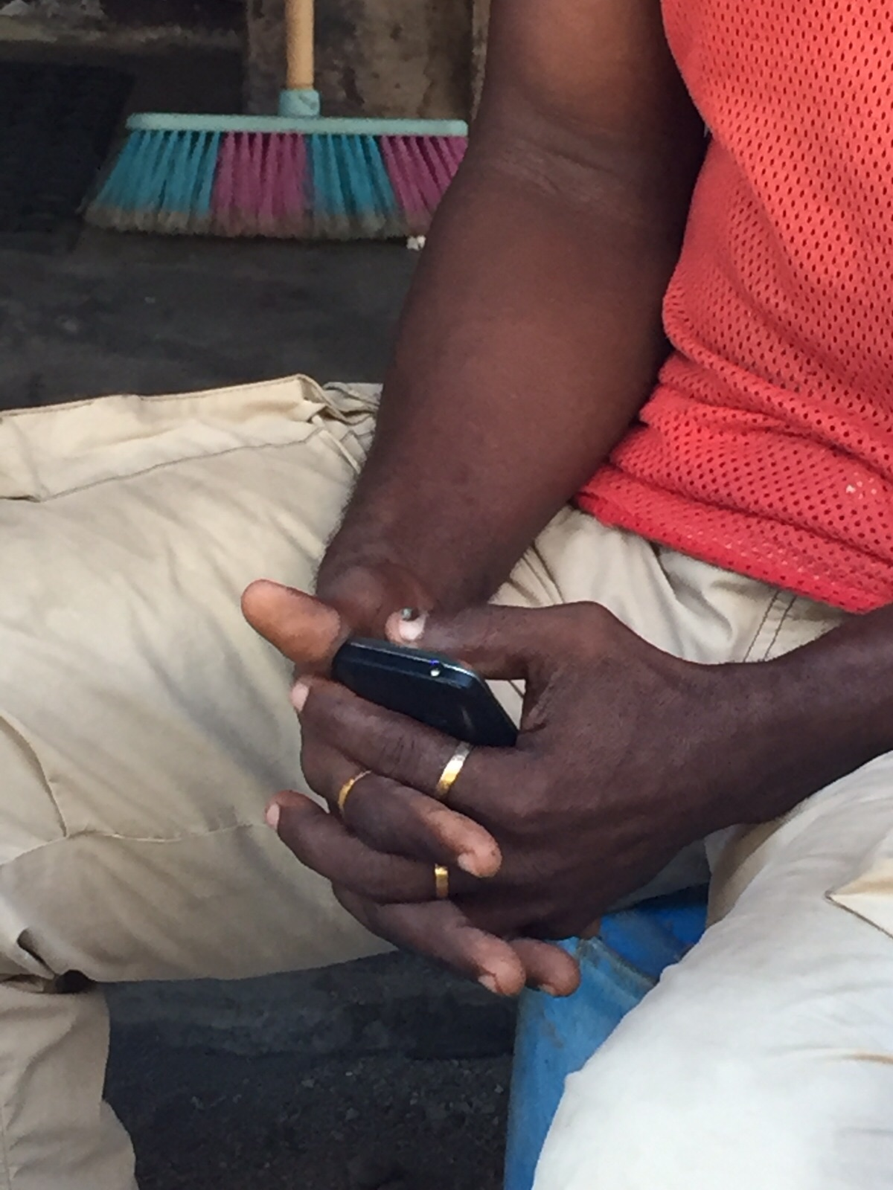
EASY TO USE: On any mobile smartphone

Slide 6
BIDHAA
MAUZO
MALENGO
MATUMIZI
AKIBA
MASLAHI
MKOPO
RIPOTI

Slide 7
BIDHAA
INGIZA BIDHAA
BEI YA KUNUNULIA
THIBITISHA
IDADI
SITISHA
ULILIPA KWA
CASH
NYINGINE
MKOPO

Slide 8
MAUZO
CHAGUA BIDHAA
UMEUZA NGAPI
BEI GANI (KILA MOJA)
THIBITISHA
MALIPO
CASH
SITISHA
MKOPO
MKOPO UNALIPWA LINI
NYINGINE
JINA LA MKOPAJI
NAMBA YA SIMU YA MKOPAJI

Slide 9
MALENGO
INGIZA LENGO
THIBITISHA
KIASI
SITISHA
MUDA
NYINGINE

Slide 10
MATUMIZI
THIBITISHA
INGIZA MATUMIZI
SITISHA
KIASI
NYINGINE

Slide 11
AKIBA
THIBITISHA
AINA YA AKIBA
SITISHA
KIASI
NYINGINE

Slide 12
MASLAHI
THIBITISHA
INGIZA JINA
SITISHA
KIASI
NYINGINE

Slide 13
MKOPO
JINA LA MKOPAJI
THIBITISHA
DENI ANALODAIWA
SITISHA
KIWANGO CHA MALIPO
TAREHE YA KUMALIZIA MKOPO
NYINGINE

Slide 14
RIPOTI
BIDHAA
FEDHA
WADAIWA
SITISHA
MAUZO
WANAONIDAI
MALENGO
AKIBA

Slide 15
RIPOTI
RIPOTI YA SIKU
RIPOTI YA WIKI
SITISHA
RIPOTI YA MWEZI

Slide 16
RIPOTI YA TAREHE 11/4/2015
VITU VILIVYOUZWA | KIASI | IDADI | JUMLA
VIATU | 8,000 | 2 | 16,000
TAA YA PIKIPIKI | 12,000 | 1 | 12,000
SUFURIA | 3,000 | 2 | 6,000
BALBU | 1,500 | 1 | 1,500
SINIA | 2,000 | 1 | 2,000
 |  | JUMLA | 37,500
SITISHA

Slide 17
RIPOTI YA WIKI YA 01/12/2015 MPAKA 17/12/2015
VITU VILIVYOUZWA | KIASI | IDADI | JUMLA
VIATU | 8,000 | 2 | 16,000
TAA YA PIKIPIKI | 12,000 | 1 | 12,000
SUFURIA | 3,000 | 2 | 6,000
BALBU | 1,500 | 1 | 1,500
SINIA | 2,000 | 1 | 2,000
 |  | JUMLA | 37,500
SITISHA

Slide 18
RIPOTI YA MWEZI DISEMBA
VITU VILIVYOUZWA | KIASI | IDADI | JUMLA
VIATU | 8,000 | 2 | 16,000
TAA YA PIKIPIKI | 12,000 | 1 | 12,000
SUFURIA | 3,000 | 2 | 6,000
BALBU | 1,500 | 1 | 1,500
SINIA | 2,000 | 1 | 2,000
 |  | JUMLA | 37,500
SITISHA

Slide 19
Customer Segment Small Retail Business (Duka –Duka) | Key Activities Design App Develop App Marketing/Sales Data Storage location Acquire Funding IP | Value Proposition Low cost and easily available tool to help achieve savings goals | Relationships Dedicated Sales/Training FAQ’s link Community (Savings groups) | Channels Samrtphones ---need internet connection to download initially Door to door Word of mouth (MNO Agents) Savings Groups Bank Agents
Key Partners Developers Funding Partners Distributors Google/Apple SG Stakeholders | Key Resources Develporers (HR) Fin. Resources
Revenue Stream Monthly fees Advertising/external marketing Per download
Cost Structures Data storage costs Development costs Sales/marketing costs | Value Proposition Low-cost easily available budgeting tool to help achieve savings goals

Slide 20
THANKS!
Any questions?

